Slide 1



The Rise of Agentic AI
Building Autonomous AI that Understands, Decides, and Acts
Version 5.9
Zia Khan
MBA, MSE, MAC, MA, CPA, CMA
https://www.linkedin.com/in/ziaukhan/
https://www.facebook.com/ziakhan/
Notes:
"The Rise of Agentic AI," explores the rapid evolution of artificial intelligence, particularly generative AI. The presentation highlights the crucial role of neural networks, GPUs, and transformers in enabling AI to think, learn quickly, and communicate effectively. It then dives into the concept of "agentic AI," where AI systems can act independently, making decisions and taking actions like human beings. The presentation outlines a roadmap for developing agentic AI systems, encompassing various stages from basic chatbots to complex, self-governing organisations. Finally, it emphasises the importance of bold leadership in navigating the AI revolution and the need to embrace the "AI or die" mantra to ensure continued growth and prosperity.

Slide 2
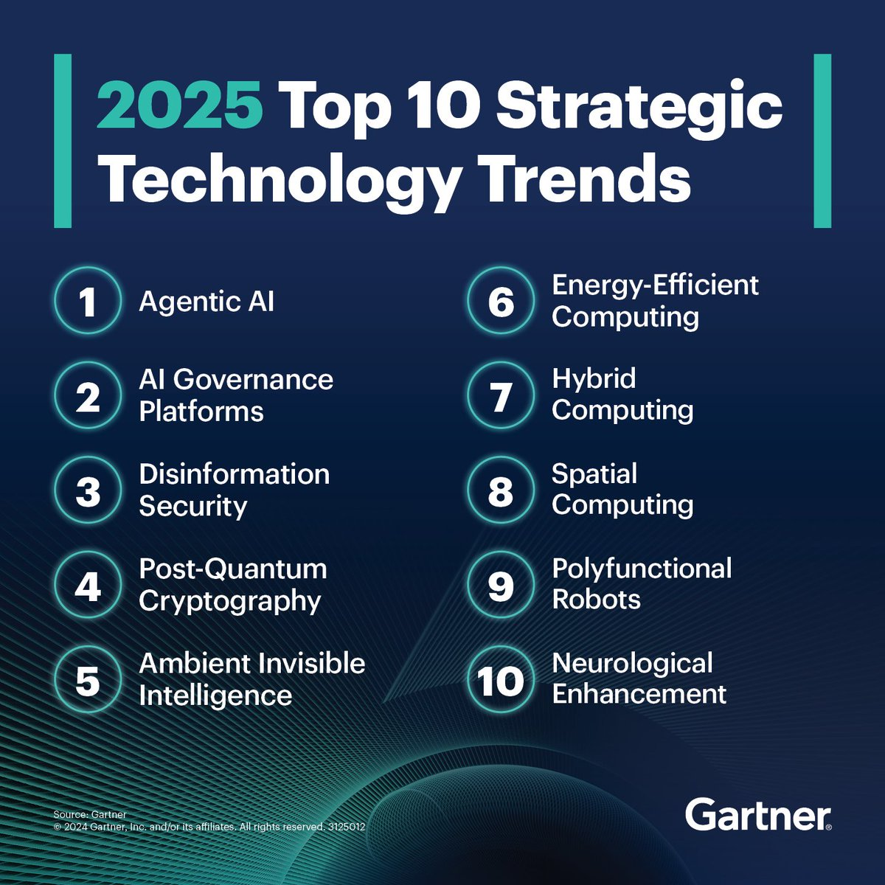

Slide 3
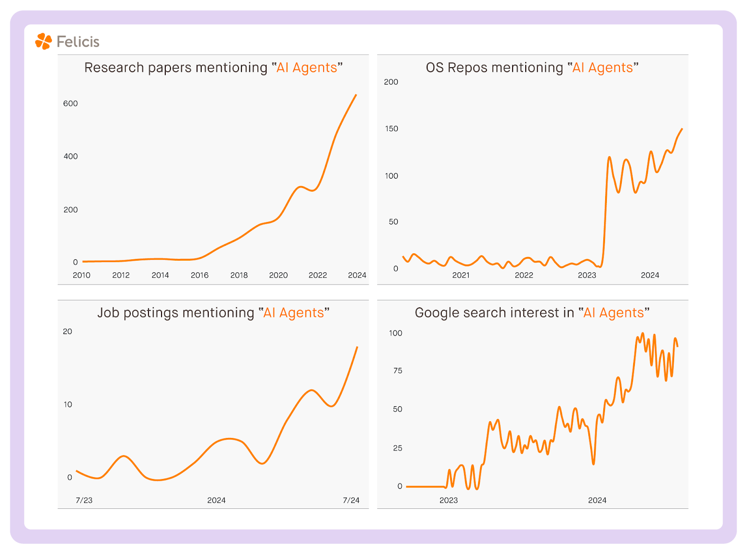
The Rise of the AI Agents
Notes:
https://www.felicis.com/insight/the-agentic-web
Recently noticed an inflection in search volume, open-source repositories, job postings, and research papers about AI Agents.

Slide 4
Problem Solving Focus
Agentic AI (All) Education is About Learning to Think and Solve Problems

Slide 5
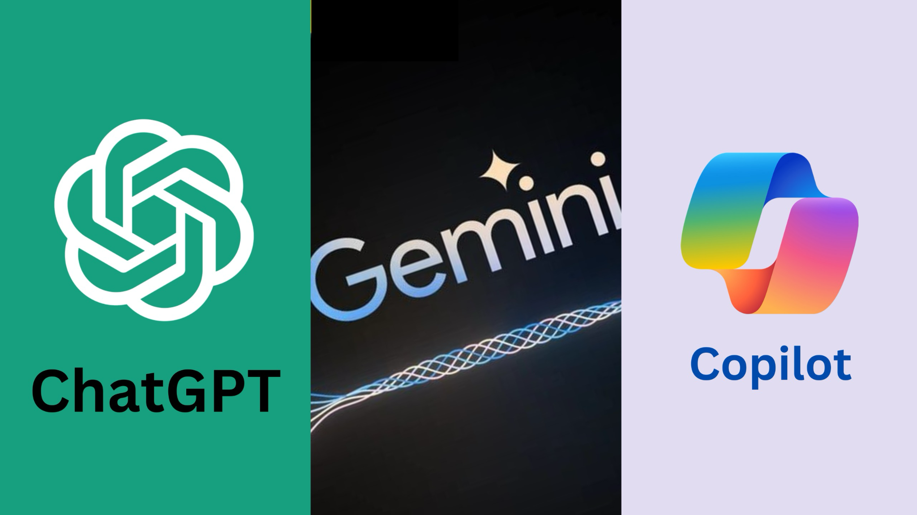
Generative AI Has Changed The World In Two Years

Slide 6
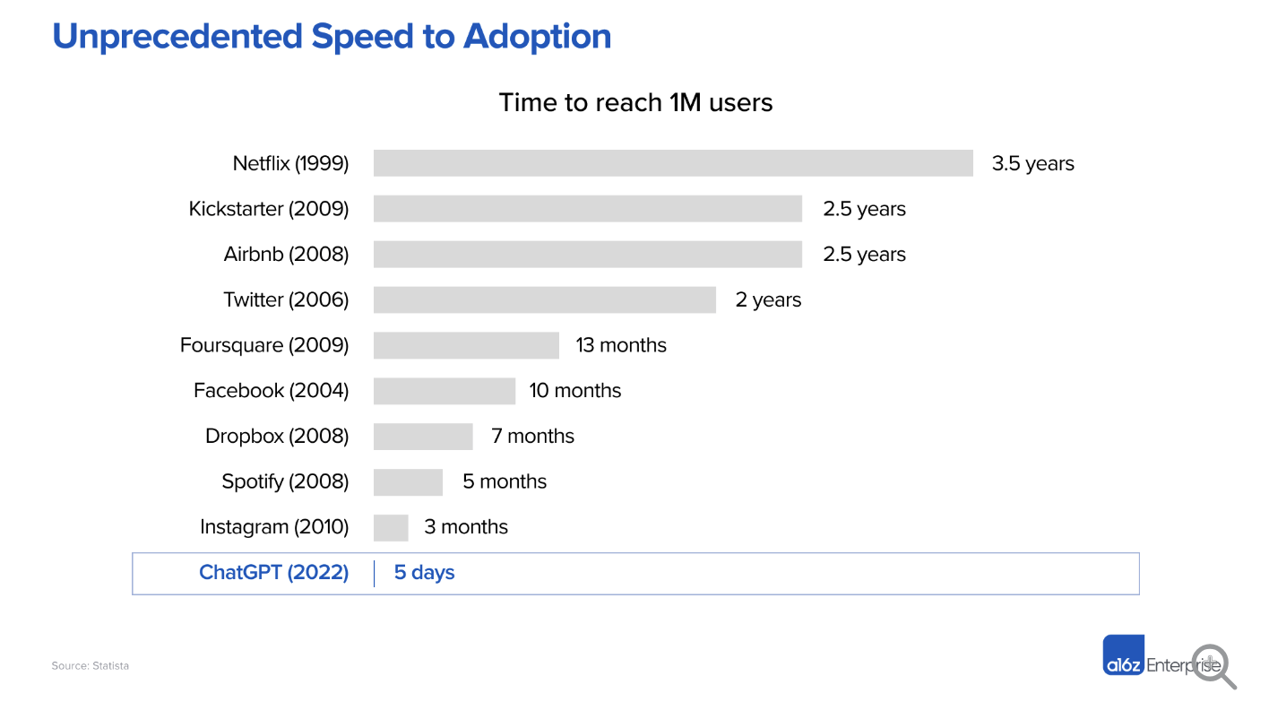
Notes:
https://a16z.com/the-economic-case-for-generative-ai-and-foundation-models/

Slide 7
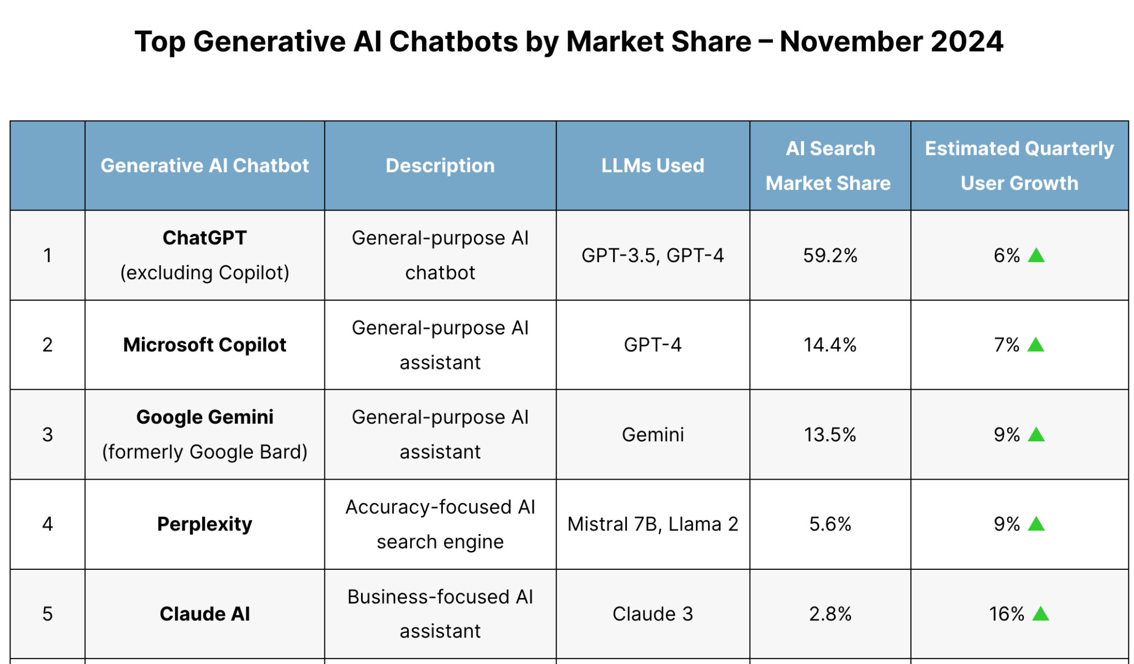
Notes:
A significant portion of Perplexity AI's user base is in India. As of the latest data, approximately 22.16% of Perplexity AI's users are based in India, making it one of the top countries for the platform. Indonesia also has a substantial user base, with around 24.78% of users
https://explodingtopics.com/blog/perplexity-ai-stats

Slide 8
LLM Web Apps
https://chatgpt.com/
https://huggingface.co/chat/
https://gemini.google.com/app
https://copilot.microsoft.com/
https://claude.ai/

Slide 9
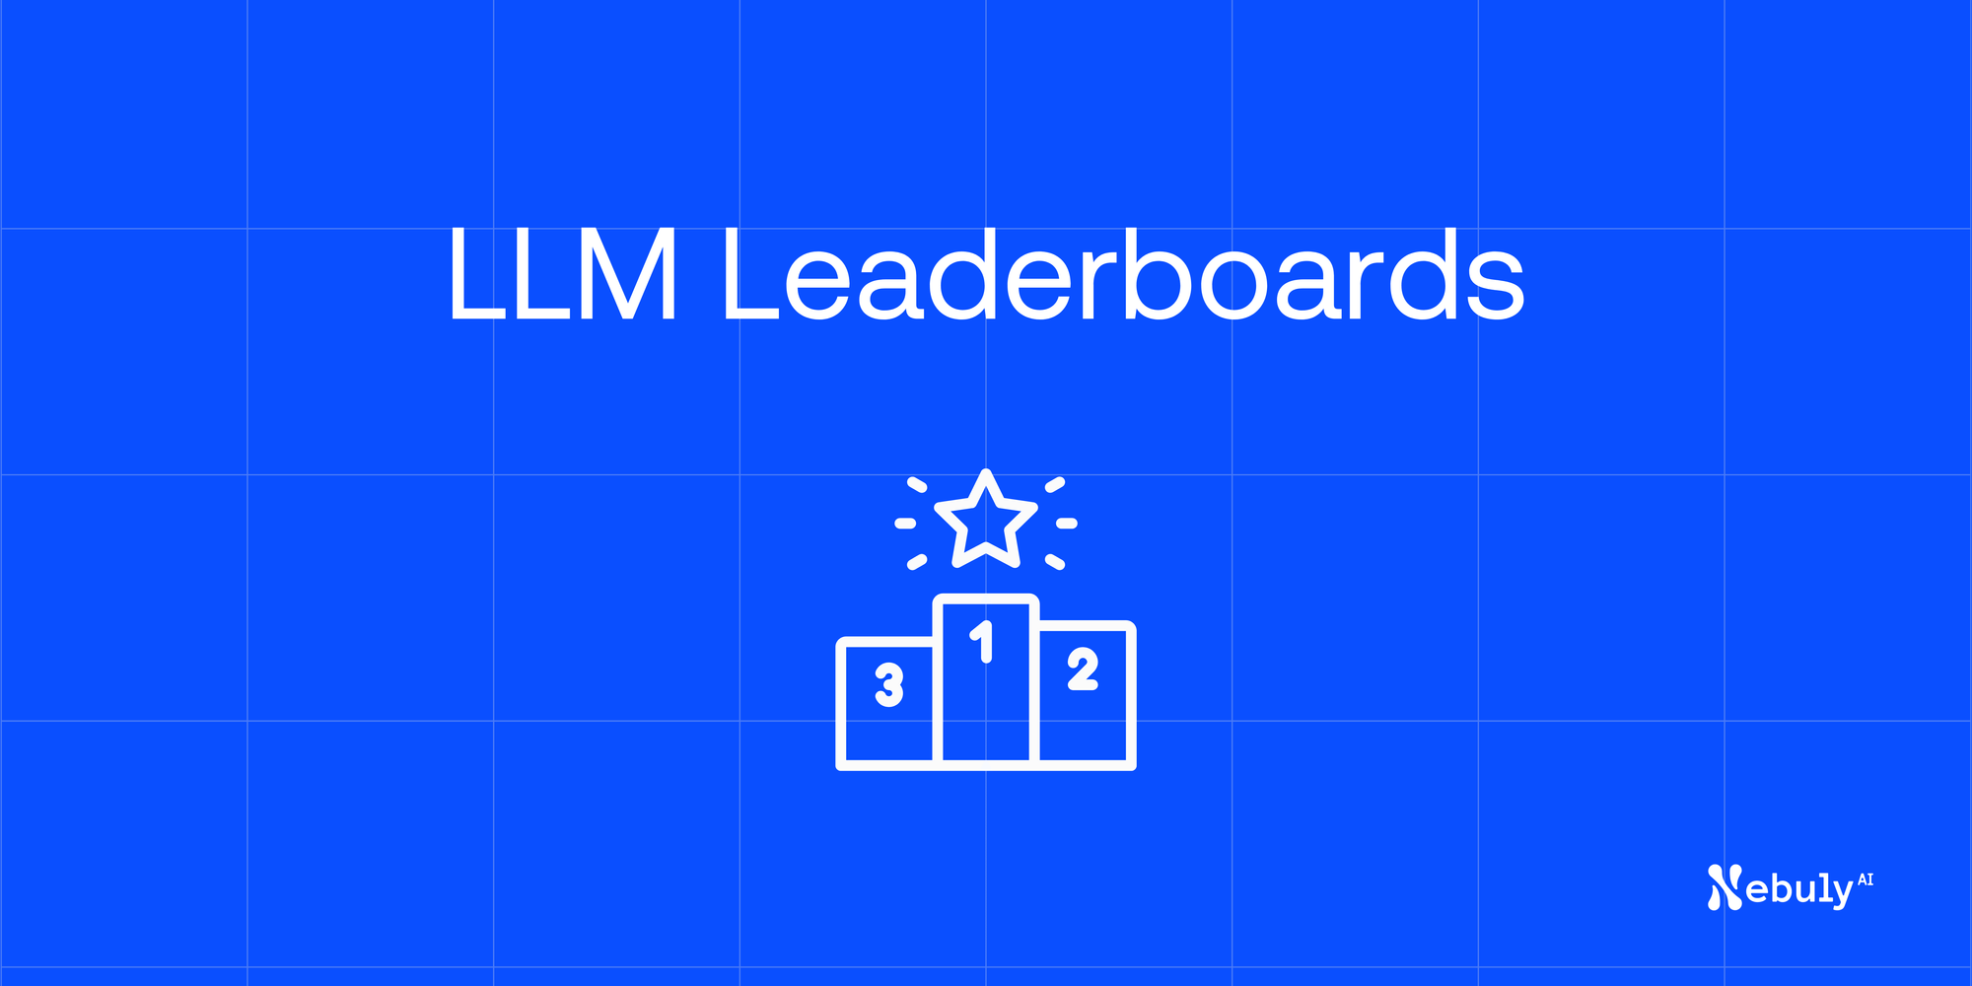
https://www.nebuly.com/blog/llm-leaderboards

Slide 10
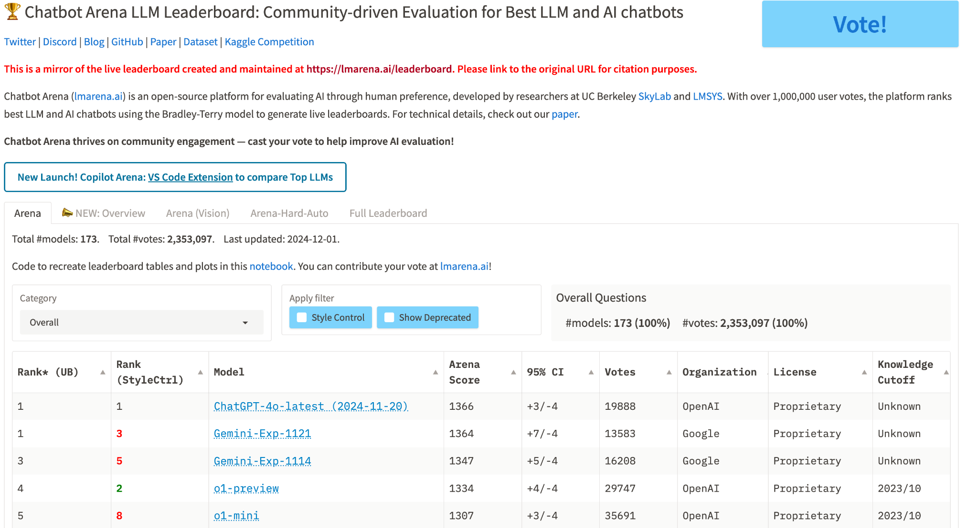
https://lmarena.ai/?leaderboard

Slide 11
The Three Waves of AI
Predictive AI
Generative AI
Agentic AI
Focus on analyzing data to predict outcomes.
Analyze past data to predict future outcomes.
Why It Mattered: Enabled data-driven decision-making.
Focus on creating content from data.
Creating content (text, images, code, videos).
Why It Mattered: Empowered creativity and productivity.
Focus on autonomous actions and learning iteratively.
Autonomous actions, environment interaction, iterative learning.
Why It Matters: AI becomes proactive, managing complex tasks.

Slide 12
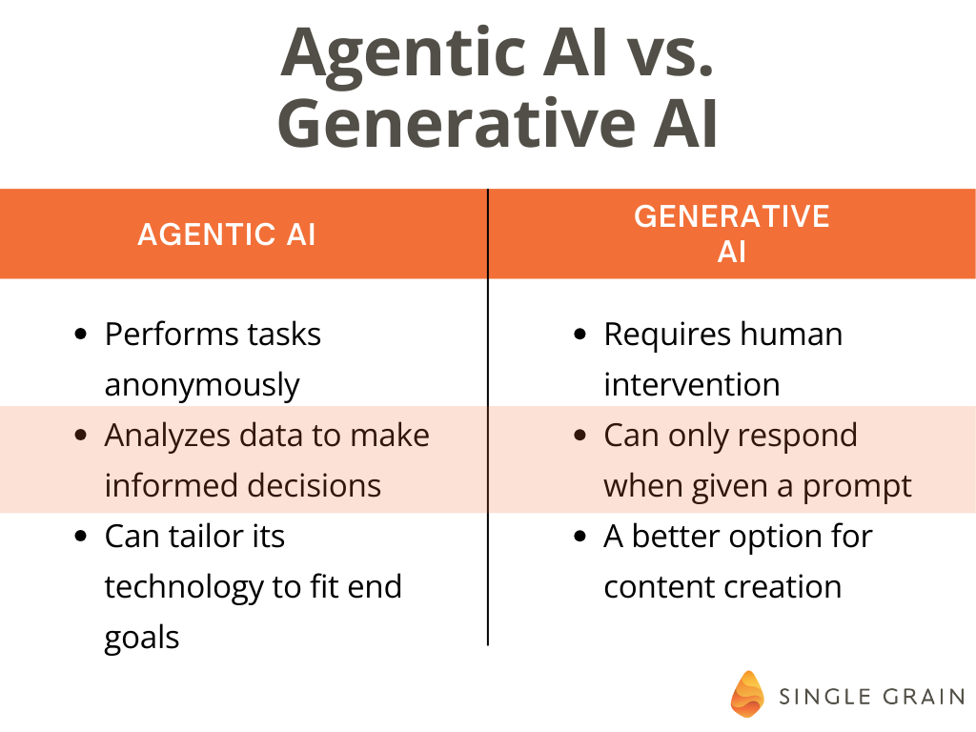

Slide 13
AI Factories
Just like we generate electricity, we're now going to be generating AI, these generators are going to be running 24/7.
This will shift the trillion-dollar traditional data centers to accelerated computing and build a new type of data center – AI factories – to produce a new commodity: artificial intelligence."
AI factories running 24/7 to produce AI outputs – whether it's language processing, image creation, or complex data analysis.
Companies will offer AI capabilities as a utility, similar to how electricity is provided.
It could lead to a world where AI is as ubiquitous and essential as electricity, transforming industries and creating new opportunities.
Notes:
https://www.techspot.com/news/105679-nvidia-ceo-jensen-huang-envisions-247-ai-factories.html

Slide 14

AI Agents will Replace Apps
Your Apps Are on Borrowed Time.
AI Agents Are on the Way

Slide 15
Tool Calling: A Core Feature of Agentic AI
Tool calling enables AI agents to autonomously select and utilize external tools or APIs to accomplish tasks beyond their inherent capabilities.
Significance in Agentic AI:
Enhances problem-solving by allowing AI to access specialized resources.
Facilitates dynamic decision-making through real-time data retrieval and processing.
Expands the functional scope of AI agents, enabling them to perform complex, multi-step operations.
Example:
An AI agent tasked with planning a trip can autonomously access flight booking APIs, hotel reservation systems, and local event databases to create a comprehensive itinerary.
Notes:
https://platform.openai.com/docs/guides/function-calling

Slide 16
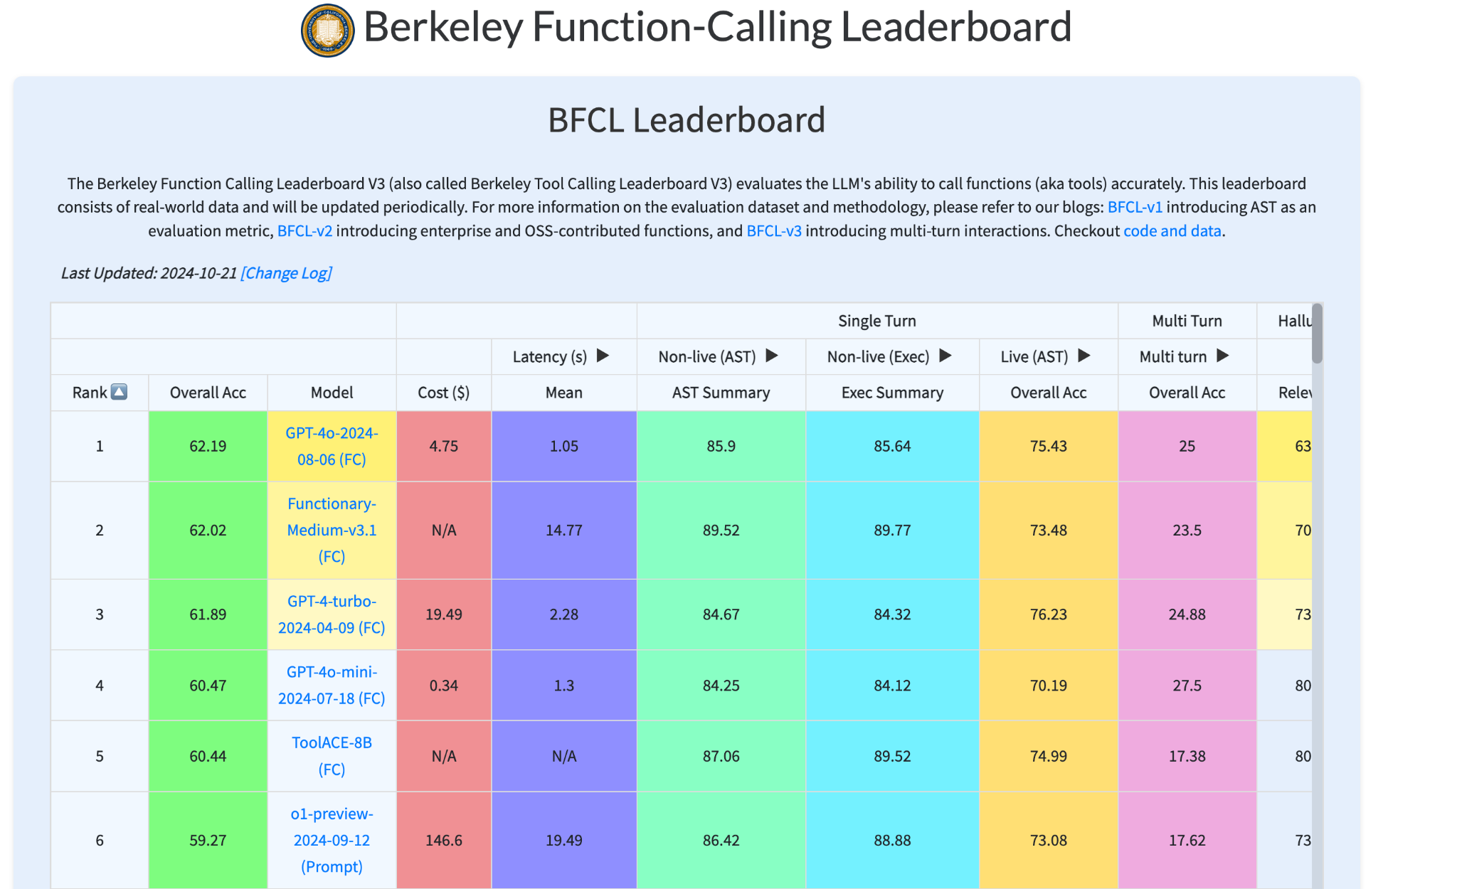
Best LLMs for Agentic AI
Notes:
https://gorilla.cs.berkeley.edu/leaderboard.html
If we press the cost column we see Gemini-1.5-Flash-002 (FC) is the least costly for agentic development also, its latency is also the lowest, which is important for agentic calls

Slide 17
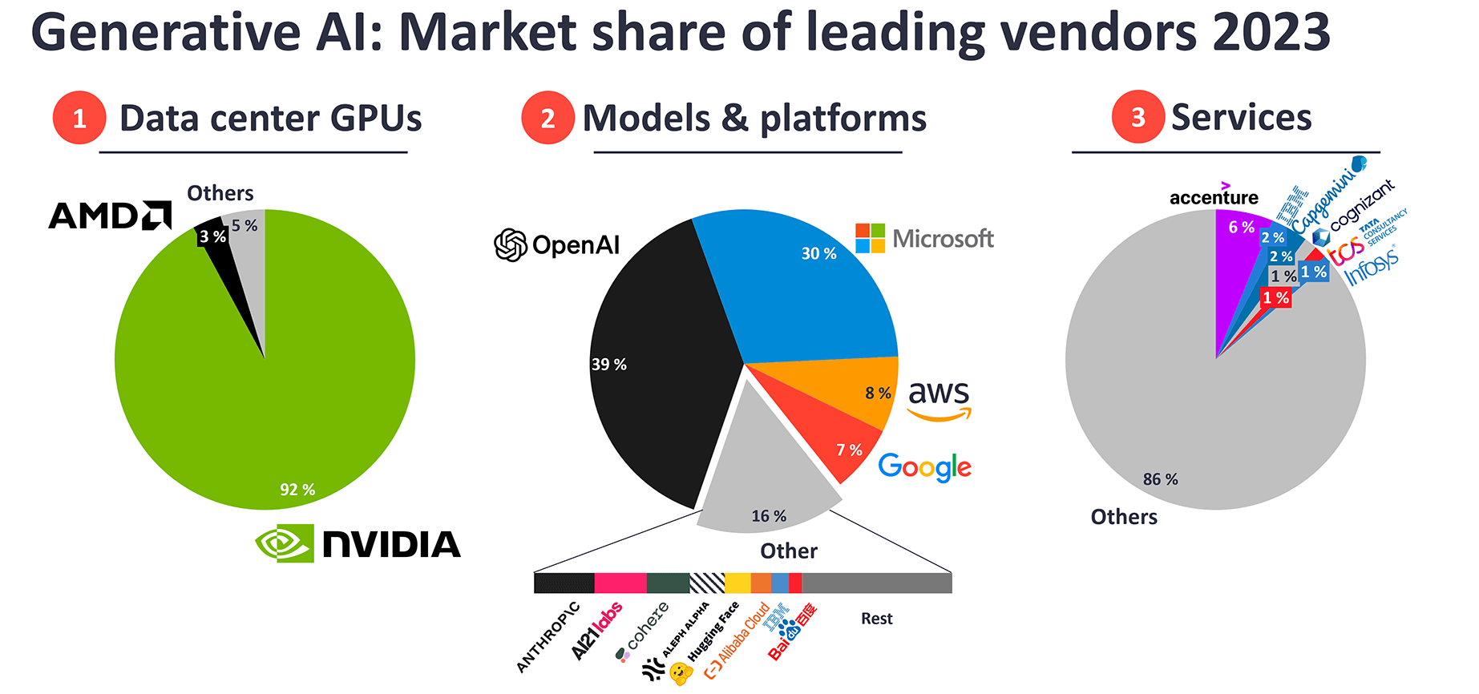

Slide 18
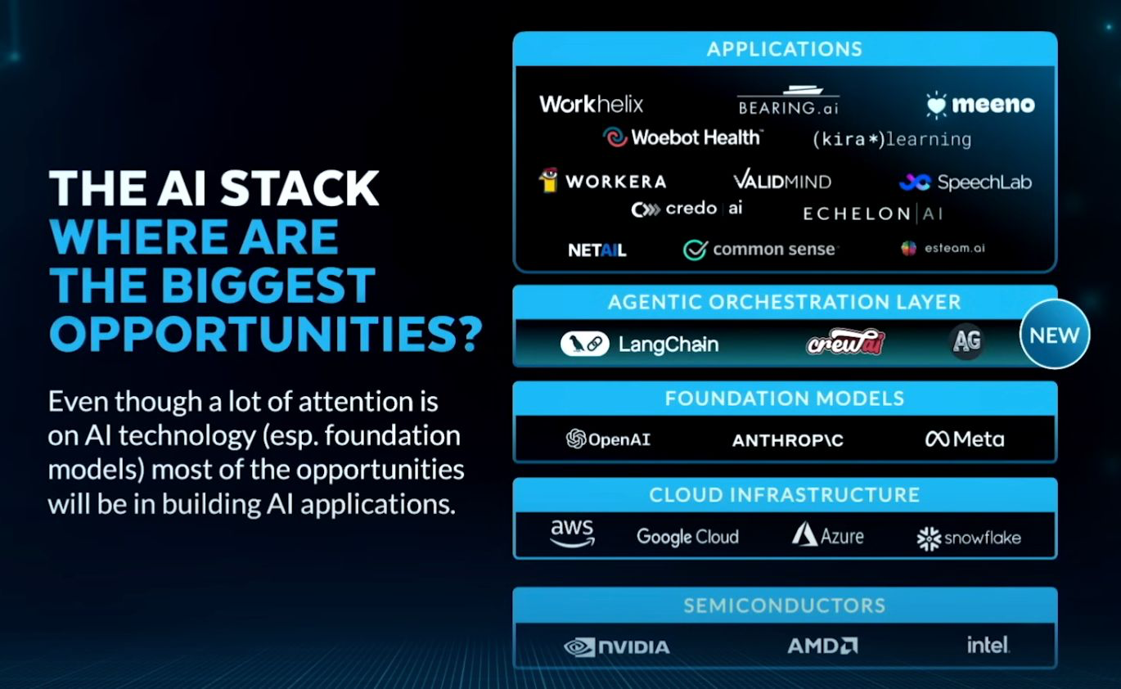
Notes:
https://www.youtube.com/watch?v=KrRD7r7y7NY

Slide 19
Financial Projections
Economic Growth and Productivity
Global GDP Contribution: AI could add approximately $13 trillion to the global economy by 2030, translating to an annual increase of about 1.2% in GDP growth. (McKinsey & Company). Jensen Huang, CEO of NVIDIA is predicting $100 trillion increase in global economy.
Productivity Enhancement: Generative AI technologies are projected to boost global GDP by 7%, equating to nearly $7 trillion, and elevate productivity growth by 1.5 percentage points over a decade. (Goldman Sachs)
Investment Trends
Rising AI Investments: Global AI investment is expected to approach $200 billion by 2025, with the U.S. contributing around $100 billion. (Goldman Sachs)
Corporate Engagement: Major corporations are increasingly investing in AI to enhance efficiency and innovation, indicating a strong commitment to integrating AI into business operations.

Slide 20
Labor Market Implications
Job Displacement and Creation: AI is anticipated to affect nearly 40% of jobs worldwide, with some roles being automated and new opportunities emerging in AI-related fields. (International Monetary Fund)
Income Inequality Concerns: The transition may exacerbate income disparities, necessitating policies to ensure equitable distribution of AI’s economic benefits.

Slide 21
Market Demand for AI Jobs
High Demand for AI Talent: Fields like agentic AI, humanoid robotics, and physical AI are seeing rapid growth.
Top industries hiring for AI roles: tech, finance, healthcare, and manufacturing .
Lucrative Salaries: AI professionals can expect salaries ranging from $150,000 to over $200,000, with opportunities only expanding.

Slide 22
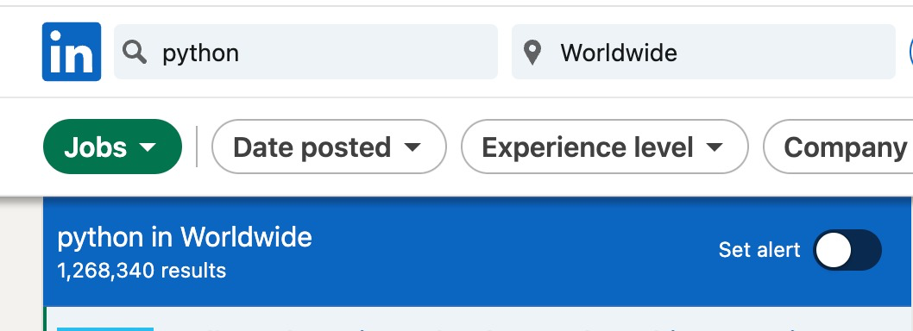
There are 1.2 million Python job openings listed on LinkedIn

Slide 23
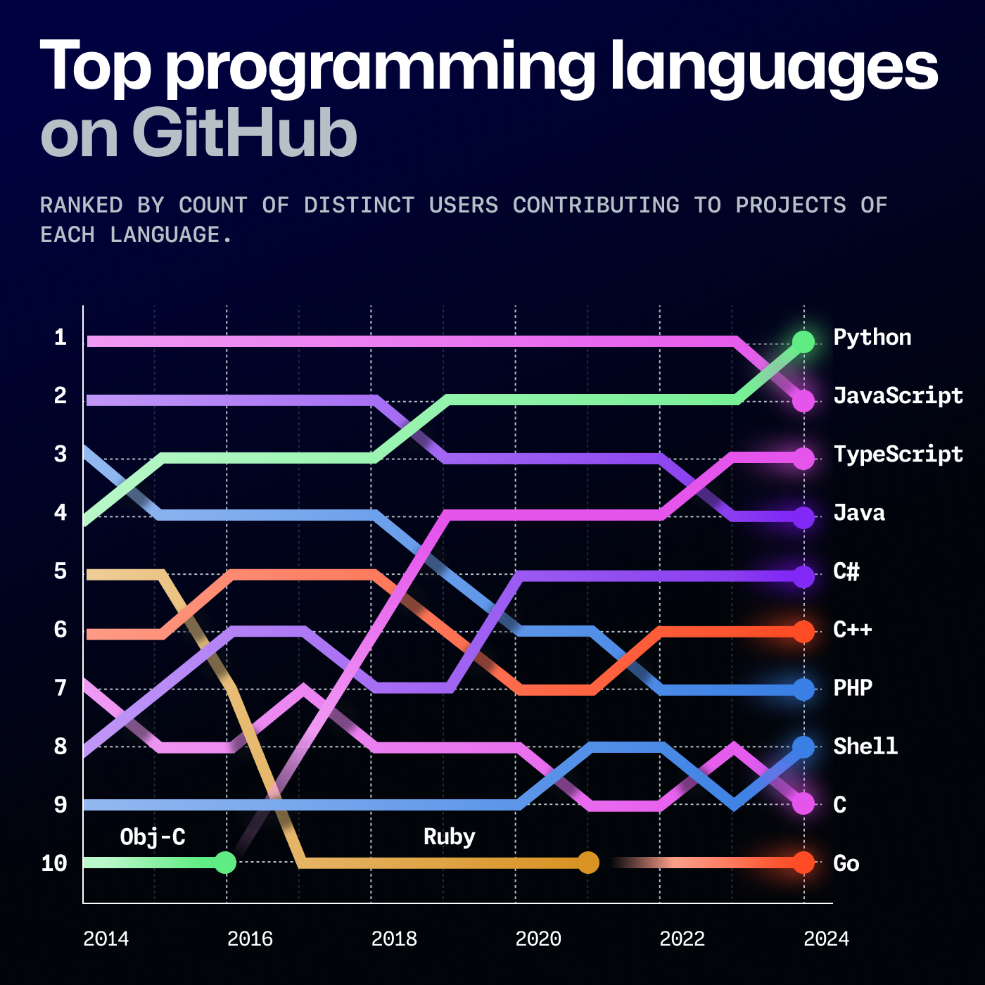
Notes:
https://github.blog/news-insights/octoverse/octoverse-2024/
https://www.youtube.com/watch?v=b5Ho2_Si6hY

Slide 24
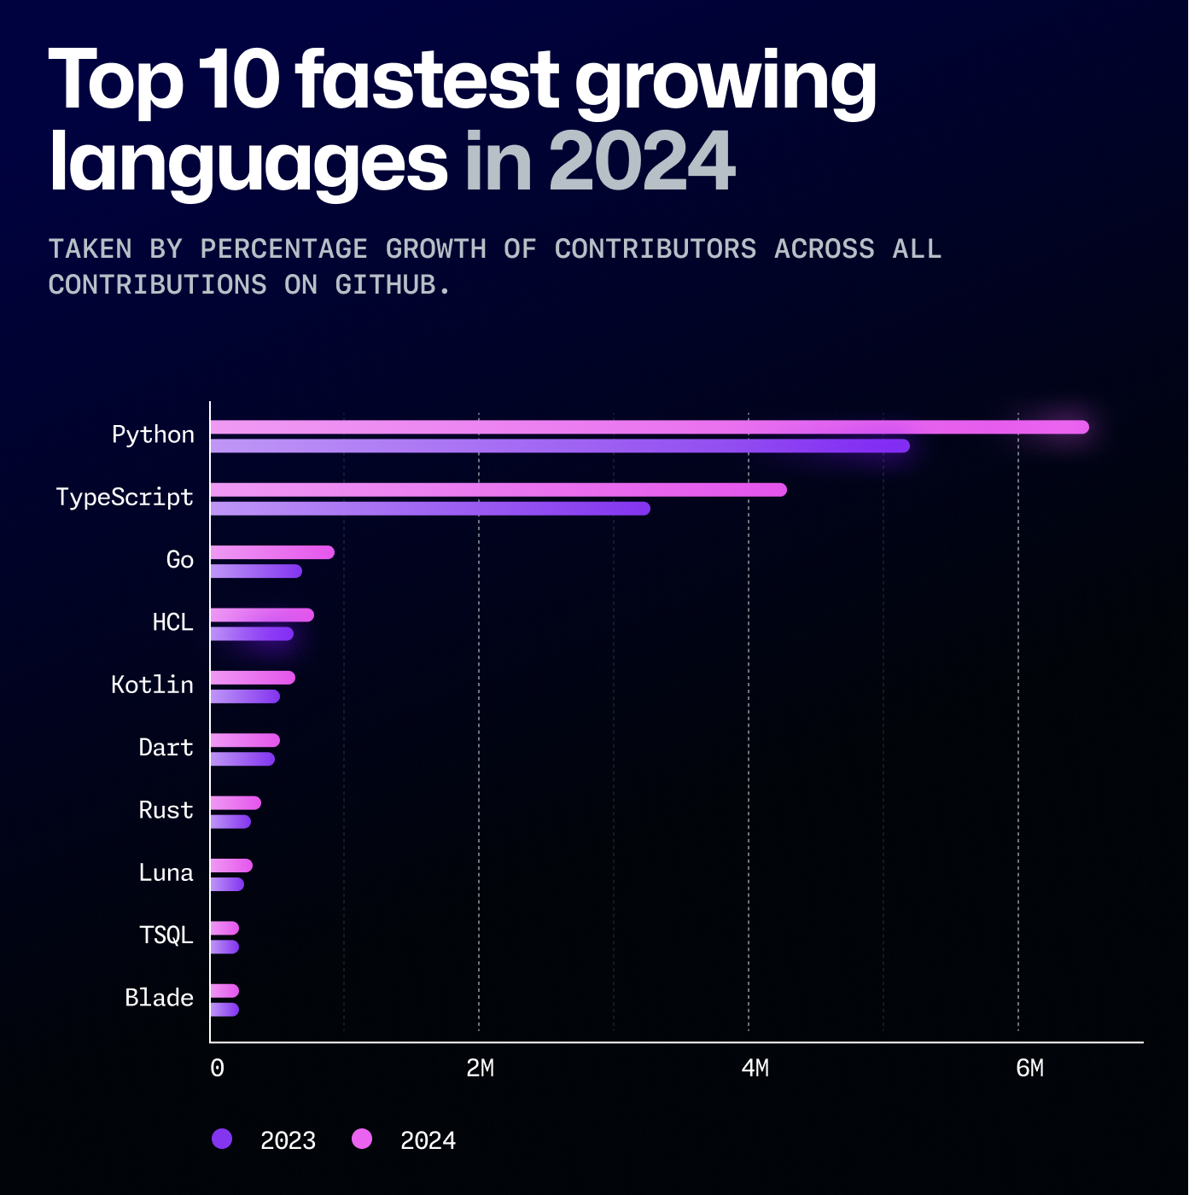
Notes:
https://github.blog/news-insights/octoverse/octoverse-2024/
https://www.youtube.com/watch?v=b5Ho2_Si6hY

Slide 25
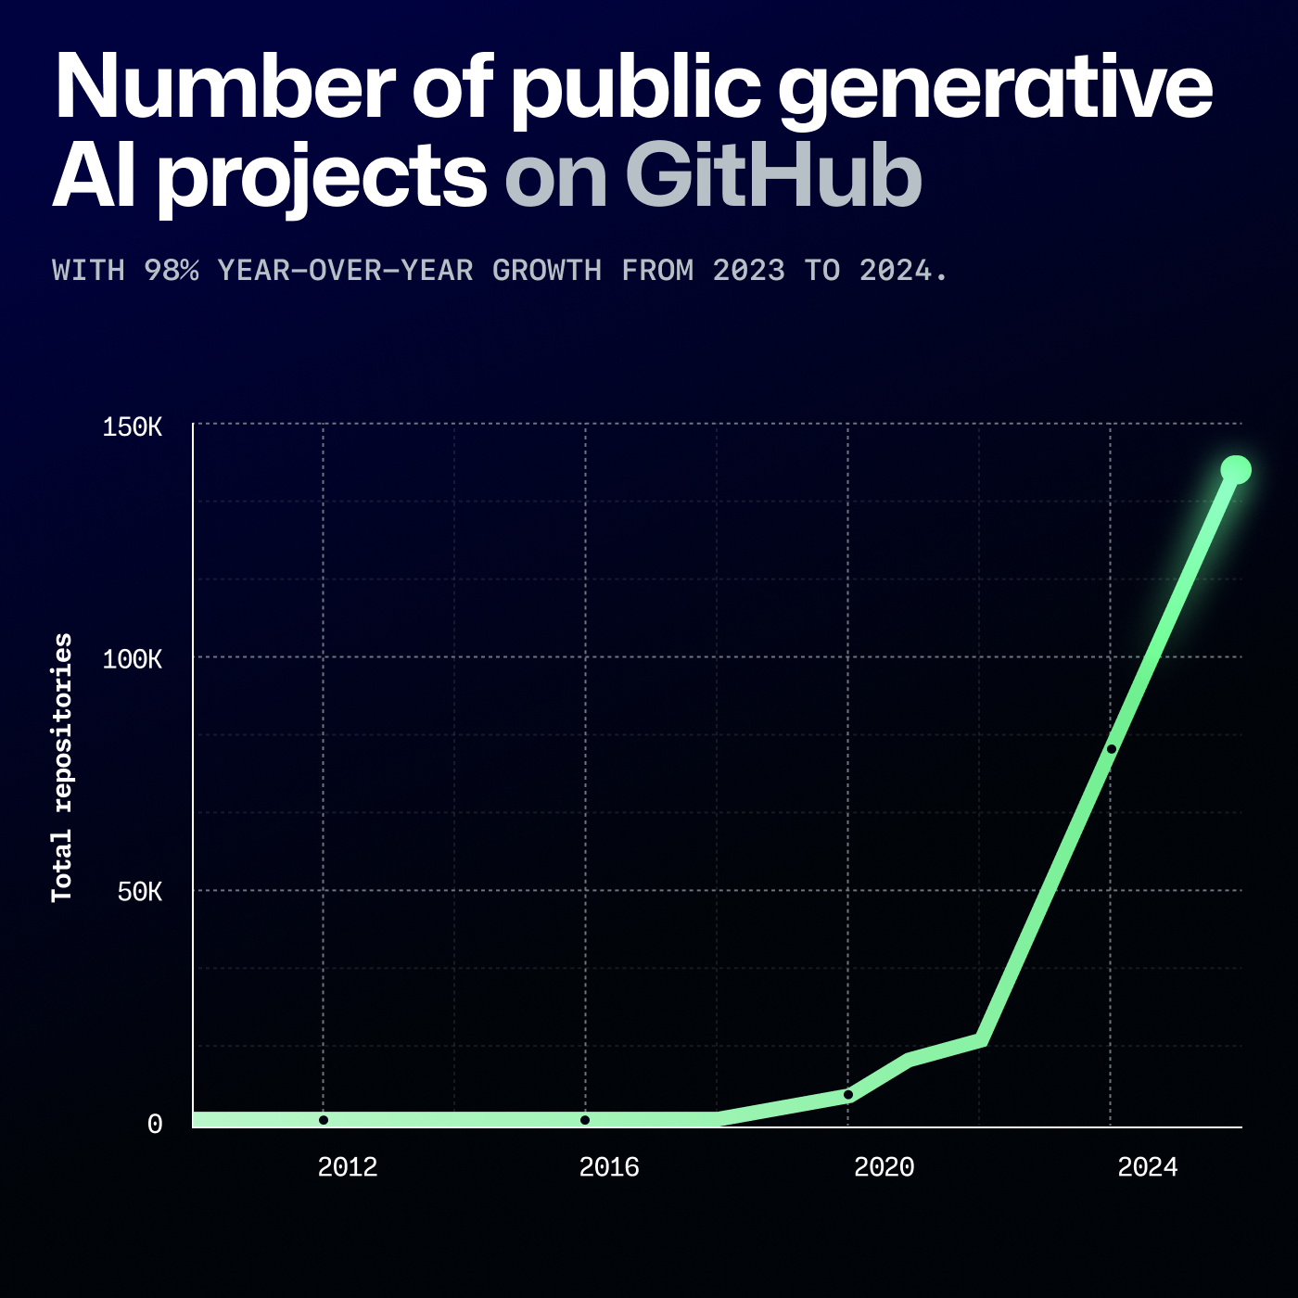
Notes:
https://github.blog/news-insights/octoverse/octoverse-2024/

Slide 26
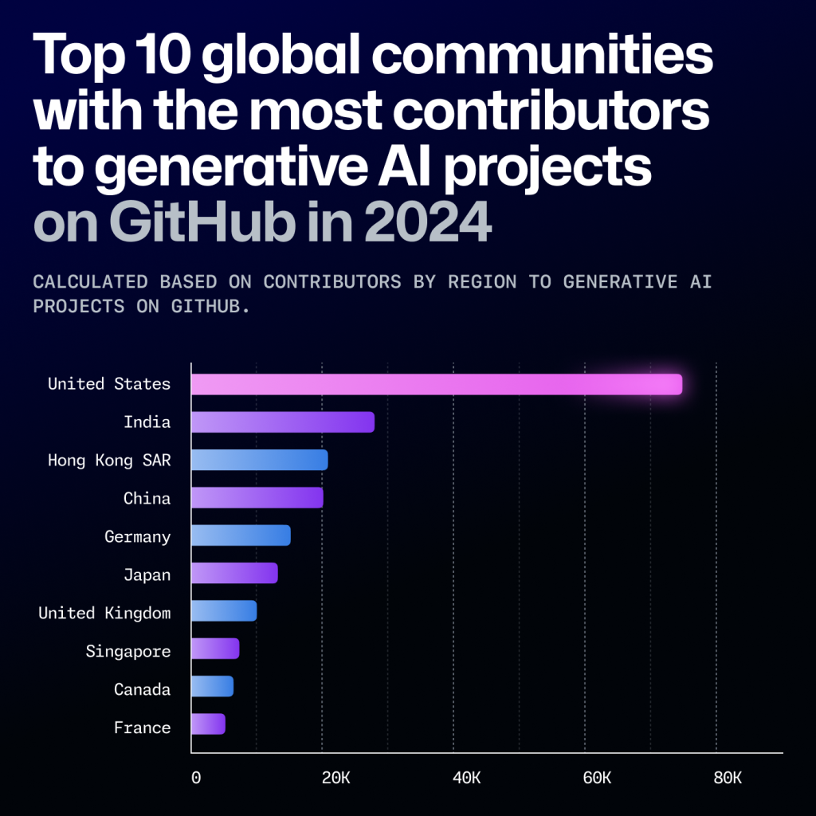
Notes:
https://github.blog/news-insights/octoverse/octoverse-2024/

Slide 27
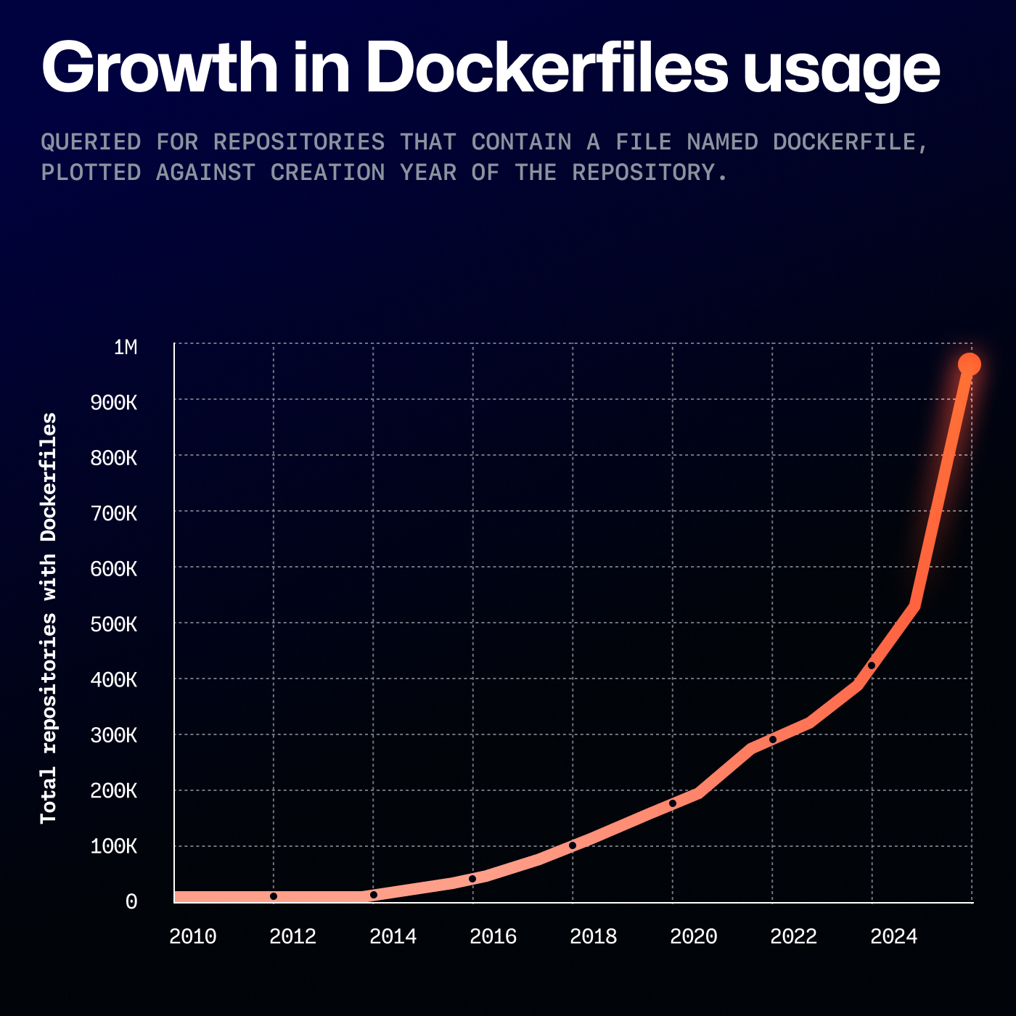
Cloud Native AI
Notes:
Cloud Native also rising with AI, it means developers are using AI based docker workloads
https://github.blog/news-insights/octoverse/octoverse-2024/

Slide 28
AI Startups and Innovation
AI Startups on the Rise: More than 90% of the startups funded by Y Combinator and Startup Factory in 2024 are AI-driven.
Major investments in AI startups signal a strong future for innovation and entrepreneurial opportunities.￼
Focus on building solutions in knowledge graphs, autonomous agents, physical AI, and custom AI agents for real-world applications.
Flexibility in AI skills empowers founders to quickly adapt, pivot, and innovate based on market needs.

Slide 29

In 2024, there is not single startup from 580 startups that was not leveraging AI

Slide 30
Career Flexibility and Freelancing in AI
Freelance Opportunities: Start contributing to real projects and earn while you learn.
Skills in cloud-native, distributed computing, and generative and agentic AI can set you up for freelancing, job, contracting, and even starting your own venture.

Slide 31
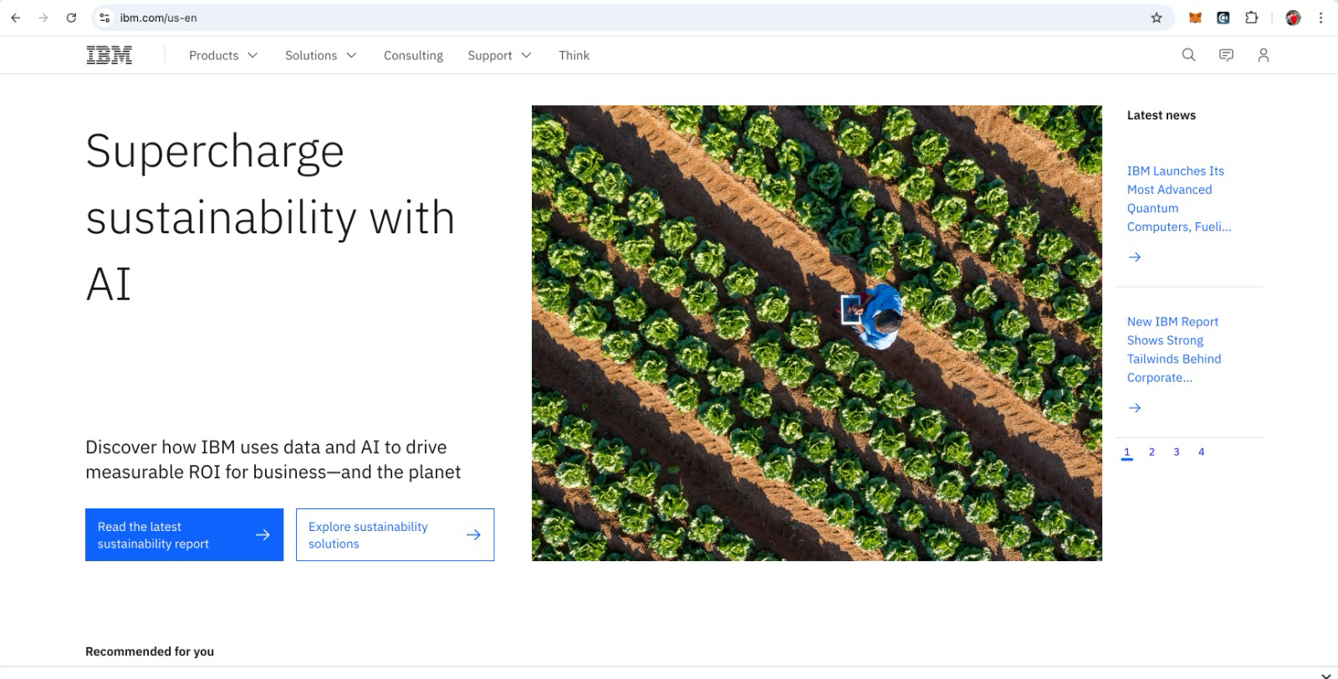
On almost any major company’s website, the first slider or banner we see is all about Generative AI

Slide 32
Join the Fourth Industrial Revolution
You should be prepared not only for high-value job roles but also for leadership in AI’s next evolution, essential to the future economy

Slide 33
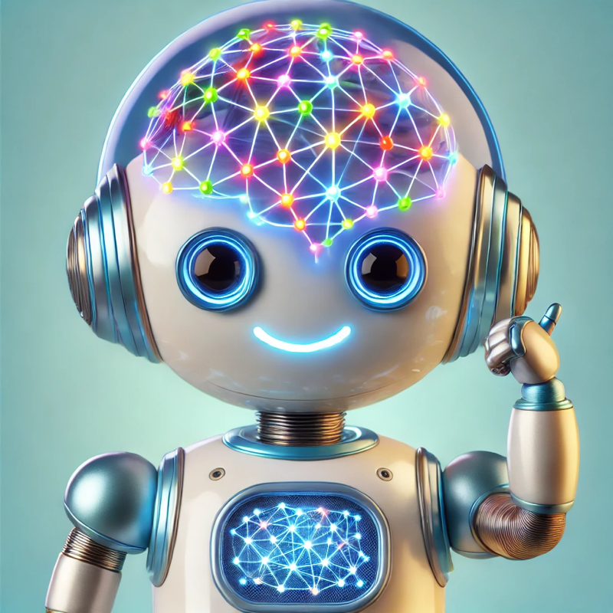
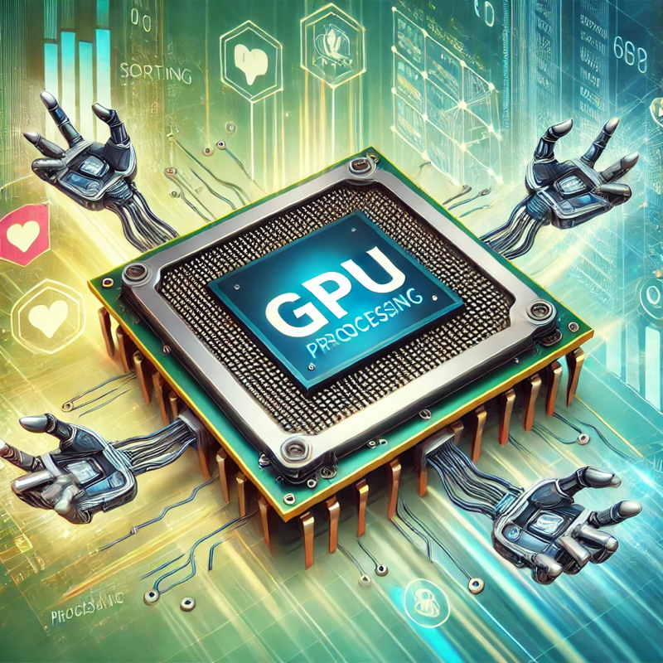

The Journey of Generative AI
Neural Networks gave AI a brain to think.
GPUs helped AI learn fast by working on many things at the same time.
Transformers gave AI the ability to understand and communicate.

Slide 34
Neural Networks – The Brain of AI
AI Thinks Like Our Brains!
AI uses Neural Networks to think.
Just like our brains have lots of tiny cells talking to each other, neural networks are like tiny computer helpers working together.
These helpers teach AI to recognize pictures, understand words, and learn new things!

Slide 35
Two Brain Cells Communicating
https://www.facebook.com/share/p/1AeAQcf75a/
Notes:
https://www.facebook.com/share/p/1AeAQcf75a/

Slide 36
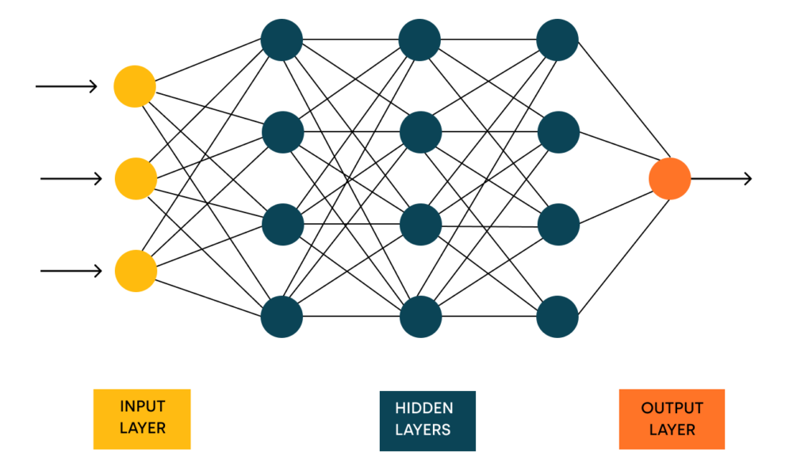
AI is Smart Because of Neural Networks!

Slide 37
GPUs – The Muscles of AI
AI Needs Strong Muscles to Work Fast – That’s GPUs!
GPUs are special computer parts that work on many things all at once.
Imagine having lots of helpers doing small jobs together at the same time—that’s how GPUs work!
This is called working in parallel.
CPUs (normal computer brains) do one thing at a time, like a person building with one block at a time.
GPUs can handle many blocks at once, making things go much faster!
With GPUs, AI can learn from tons of information quickly, just like a team finishing a big puzzle faster than one person.

Slide 38
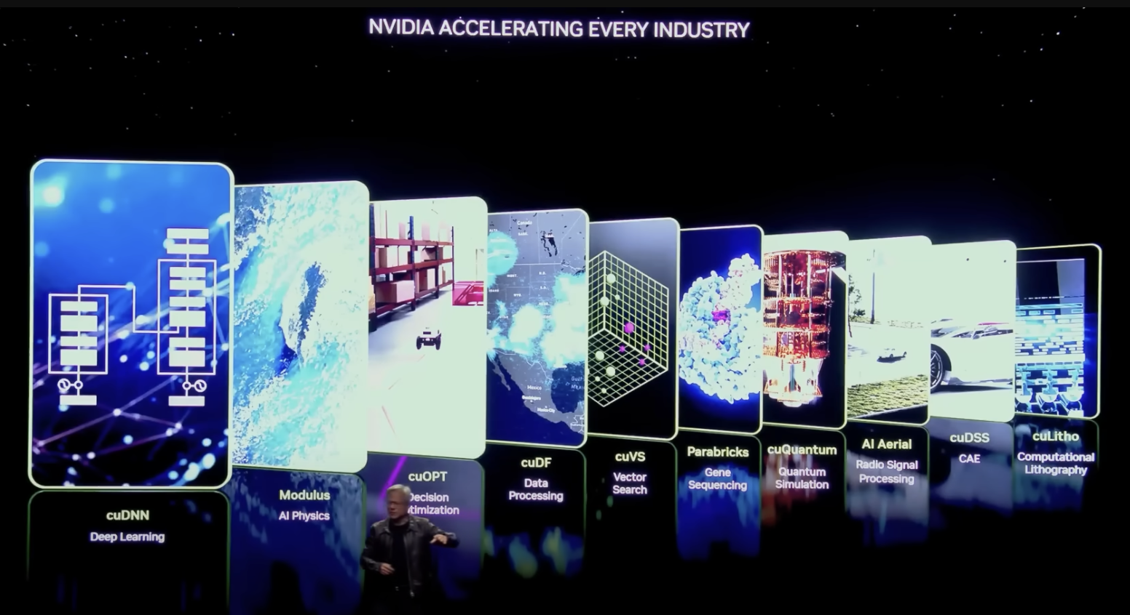
GPUs accelerate processes up to 100 times faster
Notes:
https://www.youtube.com/watch?v=JmpBqphgNhc

Slide 39
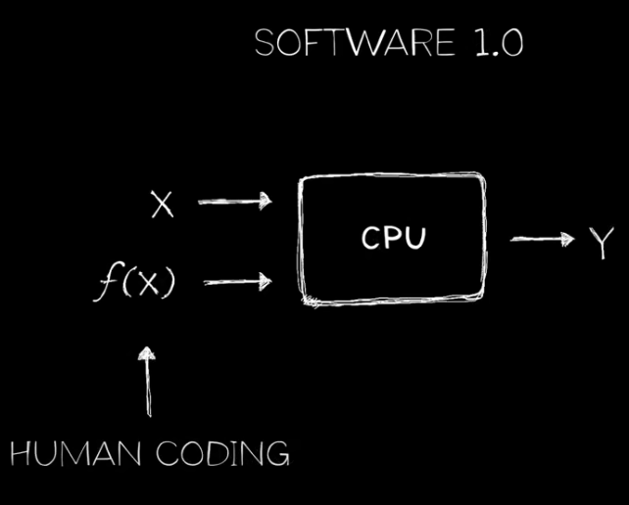
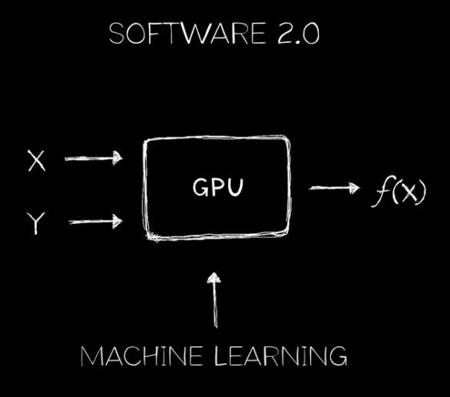
GPUs accelerate processes up to 100 times faster
Trained Model

Slide 40
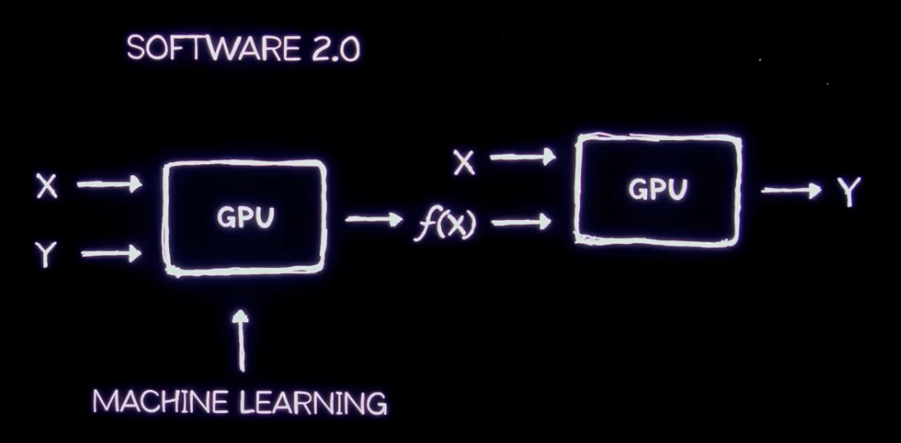
GPUs accelerate processes up to 100 times faster
Inference
Training
Trained Model

Slide 41

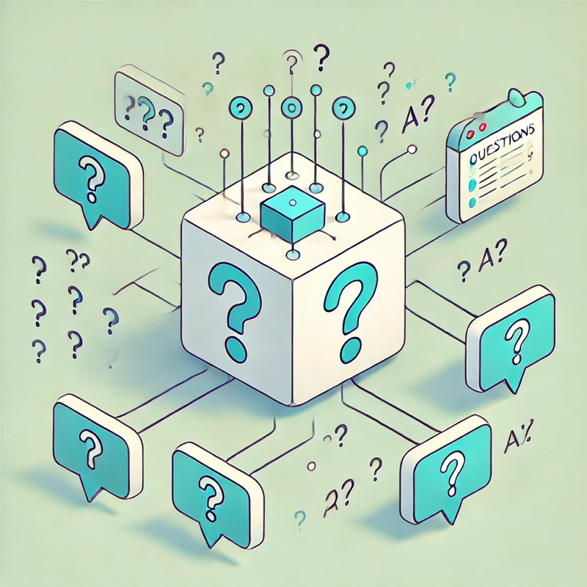
Two-Step Lifecycle and AI Model Pipeline
Training
Inference
Teaching AI to Understand Language
Using AI to Generate Responses

Slide 42
Step 1: Training – Teaching AI to Understand Language
What is Training?
Training is the process of teaching the model to understand language patterns, facts, and context.
Massive Data Sets:
The model is exposed to vast amounts of text data (books, websites, articles) to learn vocabulary, grammar, and concepts.
How It Learns:
The model identifies patterns in the data through neural network layers, adjusting its internal parameters with each example it sees.
Time & Resources:
Training is a long, resource-intensive process requiring powerful GPUs, distributed storage, and large-scale data centers.
Note: “Training is like teaching AI to recognize and understand language, much like a human learning by reading tons of books!”

Slide 43
Step 2: Inference – Using AI to Generate Responses
What is Inference?
Inference is the process of using the trained model to respond to inputs, such as questions, commands, or text prompts.
Fast Responses:
During inference, the model quickly retrieves learned patterns to provide a relevant response without re-training.
Optimization for Efficiency:
Inference needs to be fast and efficient, often requiring model compression and optimization techniques to reduce response time.
Real-World Applications:
Inference is where the model powers applications, like chatbots, search engines, or customer support, generating responses in real time.
Note: “Inference is like putting AI’s knowledge to work – generating answers, helping with tasks, and providing assistance instantly!”

Slide 44
Transformers – Understanding and Communication Ability of AI
Transformers Help AI Understand and Talk!
Transformers are special tools that make AI super smart with language.
They let AI read lots of words at once and understand what they mean.
Now, AI can answer our questions, tell stories, and chat with us like a friend!

Slide 45

How should companies and countries think about AI to drive growth and prosperity?
AI or Die
AI or Die
The Mantra of AI or die is real and
certainly companies and countries that do not engage will die.
Notes:
https://www.youtube.com/watch?v=uqc8PWYq9Hw

Slide 46
The Global AI Race: A New Frontier in Power
Investing in AI is now essential for global relevance.
AI is more than technology—it’s a pathway to economic power and geopolitical influence.
It also impacts the future of humanity.
The US and China are leading the AI charge.
Countries like the UK, Israel, and India are rapidly advancing.
AI is projected to add $15.7 trillion to global GDP by 2030 (source: Gartner).
Nations are investing heavily to capture these economic benefits.
Saudi Arabia Plans $100 Billion AI Project to Rival UAE.
Notes:
https://alltechmagazine.com/the-global-ai-race/

Slide 47
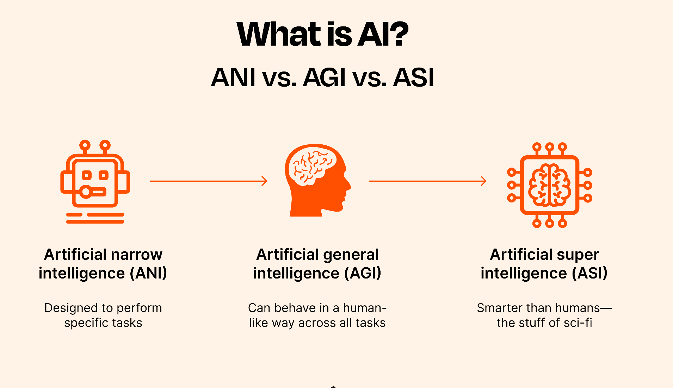

Slide 48
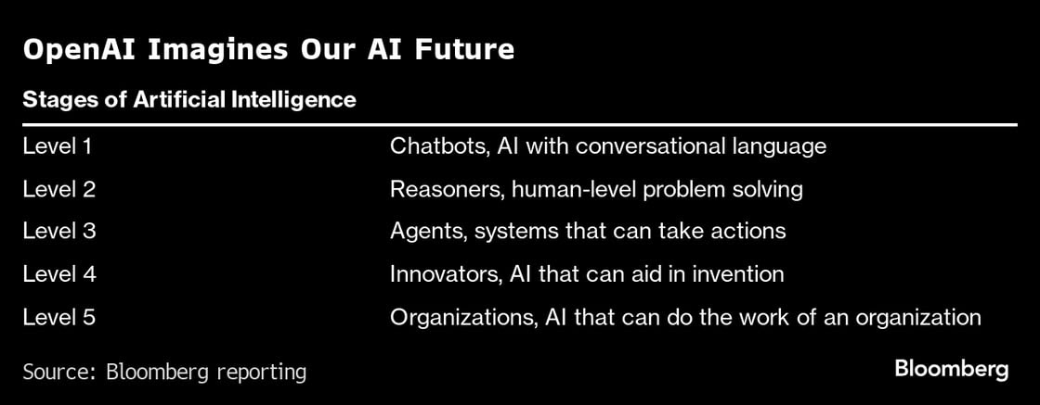
Road To AGI

Slide 49
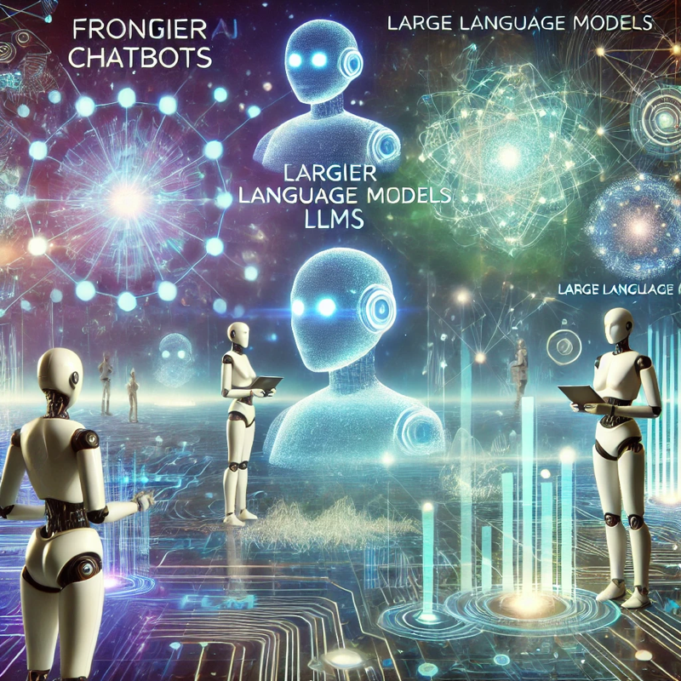
Level 1: What are Frontier LLMs
These models are trained on extensive datasets, enabling them to understand and generate human-like text, and in some cases, process multiple data types such as images and audio.
Key Characteristics of Frontier LLMs:
Scale and Complexity: Frontier LLMs often contain billions to trillions of parameters, allowing them to handle complex tasks and generate coherent, contextually relevant responses.
Multimodal Capabilities: Some frontier models are multimodal, meaning they can process and generate content across various data types, including text, images, and audio.
Foundation Models: These models serve as foundational platforms that can be fine-tuned for a wide range of applications without specific training for those tasks.

Slide 50
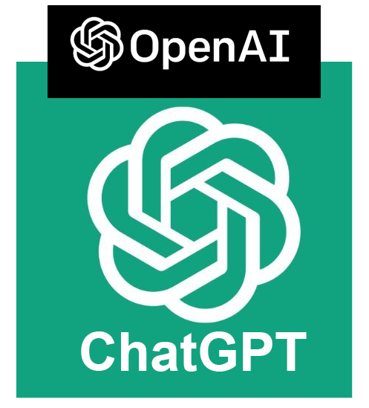


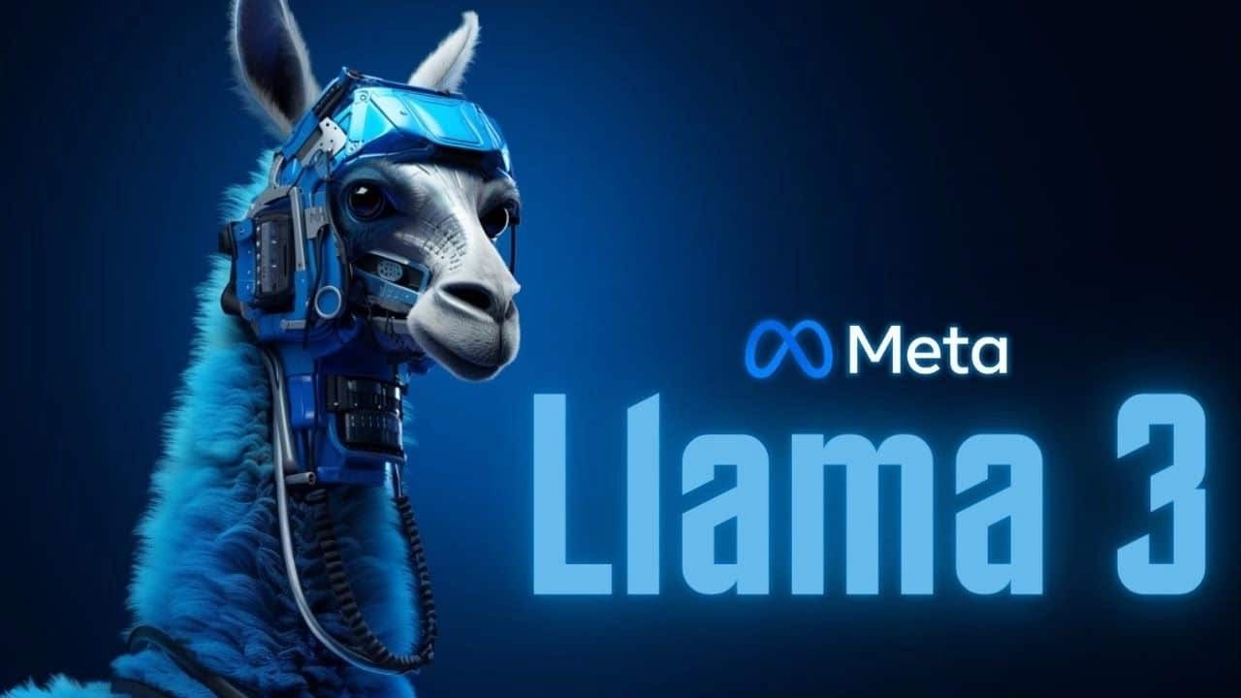
Frontier LLMs

Slide 51
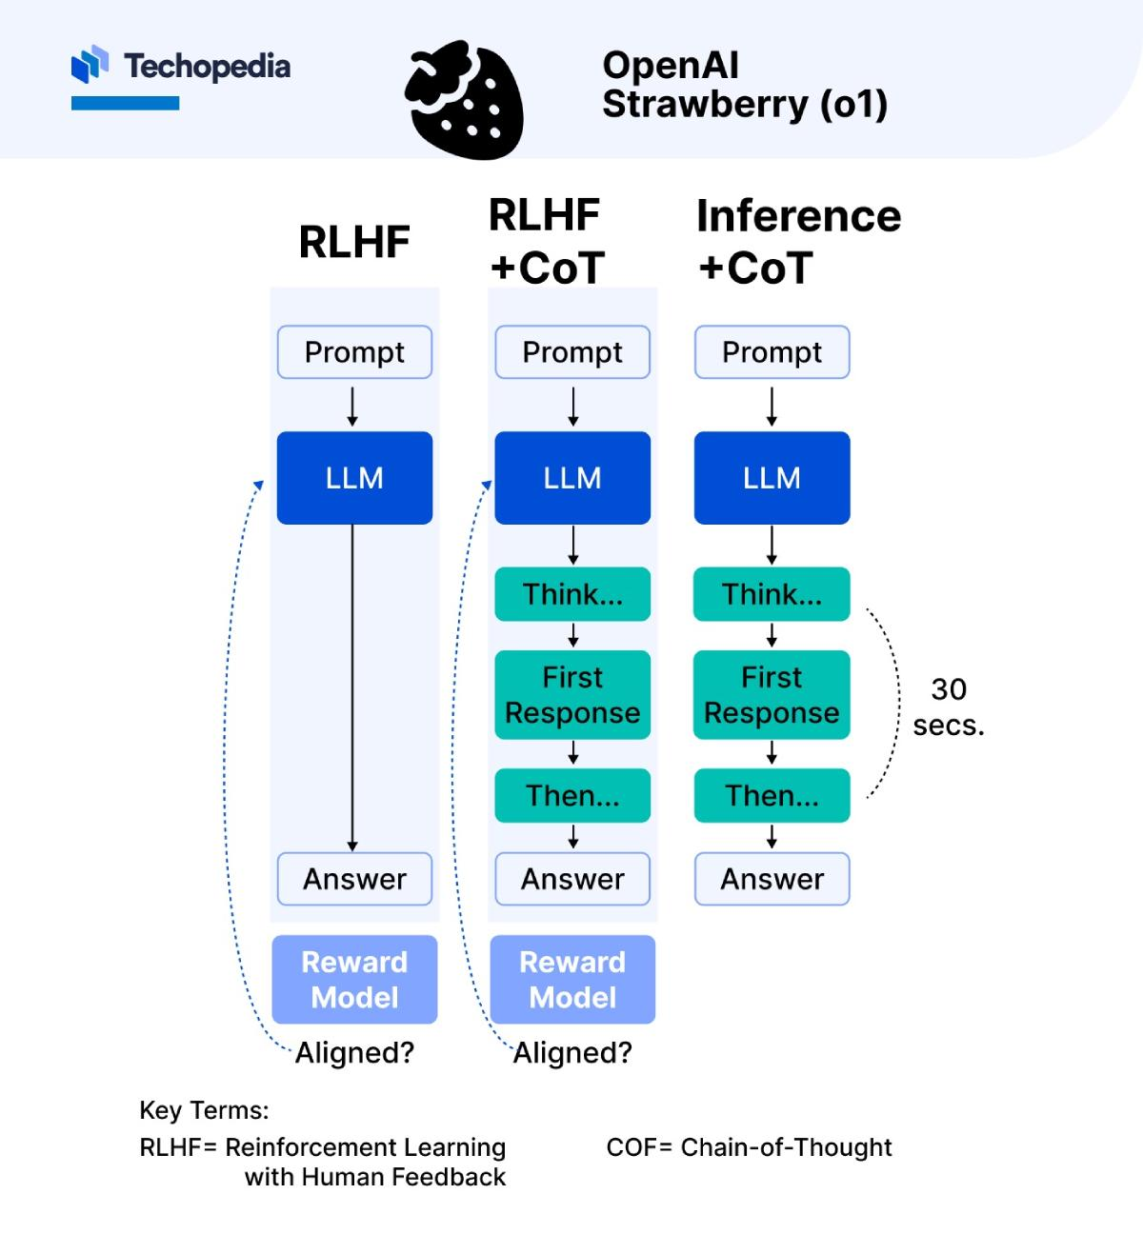
Level 2: Reasoners and OpenAI o1 Model
Notes:
This image presents a comparison of three different approaches to interacting with a large language model (LLM): RLHF (Reinforcement Learning with Human Feedback), RLHF + CoT (Chain-of-Thought), and Inference + CoT. These approaches are used in the context of training and inference for LLMs, with the aim of improving model alignment with human expectations and responses.
Here's a breakdown of each approach:
RLHF (Reinforcement Learning with Human Feedback):
This approach starts with a prompt that is fed directly into the LLM.
The LLM processes this prompt and generates an answer without intermediate reasoning steps or "thinking" stages.
After generating an answer, the reward model evaluates this answer to see if it's aligned with the desired response.
This method is direct but may lack deeper reasoning, as it generates an answer without explicitly displaying intermediate thought processes.
Key characteristic: It uses human feedback in the training loop to improve alignment but lacks an intermediate reasoning process.
In **Reinforcement Learning with Human Feedback (RLHF)**, human feedback is typically integrated during the training phase to guide the model in producing more aligned and high-quality responses. Here's a step-by-step explanation of how and where human feedback fits into the RLHF process:
1. **Initial Model Output**:
- The model receives a prompt and generates an initial response. This output can be produced by a version of the model that hasn’t yet been fine-tuned with human feedback.
2. **Human Feedback Collection**:
- Human reviewers (often called "labelers" or "annotators") evaluate the model’s response. This feedback can be provided in several ways, depending on the design of the RLHF system:
- **Scoring**: Labelers assign a score to the response based on its quality, relevance, accuracy, or alignment with human values.
- **Ranking**: If there are multiple model-generated responses to the same prompt, labelers may rank them from best to worst based on their quality.
- **Direct Edits**: In some systems, labelers may suggest edits or improvements to the response, demonstrating how the answer could be better structured or phrased.
3. **Reward Model Training**:
- The collected human feedback is then used to train a **reward model**. This reward model is a separate model that learns to predict the "desirability" or "alignment" of responses based on the feedback data from human reviewers.
- The reward model essentially learns a scoring function that assigns higher scores to responses similar to those rated highly by human reviewers.
4. **Reinforcement Learning (RL) Optimization**:
- With the reward model in place, the LLM is fine-tuned using **reinforcement learning**. In this stage:
- The LLM generates responses to various prompts, which the reward model scores based on its learned evaluation criteria.
- Using an algorithm like **Proximal Policy Optimization (PPO)** (a commonly used RL algorithm), the LLM’s parameters are adjusted to maximize the reward scores from the reward model. This process iteratively improves the LLM, encouraging it to produce responses that align more closely with human preferences as encoded in the reward model.
5. **Evaluation and Iteration**:
- The RLHF process is often repeated over multiple cycles, with human reviewers periodically providing feedback on new responses to update and refine the reward model.
- This iterative process allows the model to better align with nuanced human expectations over time.
### Summary of Where Human Feedback is Given
Human feedback is provided after the LLM generates an initial response. It is used to train a reward model that guides the LLM during reinforcement learning. The actual human interaction occurs during the reward model training phase, where human reviewers rate, rank, or edit the LLM’s responses to teach the model what is considered high-quality or aligned output. The reward model then automates this scoring process during RL optimization, reducing the need for continuous human intervention in later stages.
RLHF + CoT (Chain-of-Thought):
This approach also starts with a prompt that is fed into the LLM.
The LLM first enters a "thinking" stage, generating a first response that represents an intermediate thought or reasoning step.
After the initial thought, the LLM proceeds with additional reasoning ("Then...") until it arrives at the final answer.
The reward model evaluates this final answer to check if it is aligned with the intended response.
Chain-of-Thought (CoT) reasoning allows the LLM to break down the answer into multiple stages, potentially leading to more thoughtful and aligned responses.
Key characteristic: Incorporates intermediate steps in reasoning to improve the quality and alignment of the answer, combined with human feedback for further alignment.
Inference + CoT (Chain-of-Thought):
Similar to the previous approach, it begins with a prompt that initiates the LLM.
The LLM then goes through a series of intermediate steps ("Think..." and "Then...") to simulate a reasoning process before arriving at the final answer.
Unlike RLHF, there is no reward model involved in this setup. Instead, it's used purely for inference, where the Chain-of-Thought process helps the model improve its answer quality.
A 30-second delay is noted here, possibly indicating a typical processing time for the Chain-of-Thought reasoning to unfold and complete.
Key characteristic: Uses CoT reasoning in the inference stage without reinforcement feedback, relying on the LLM's internal capabilities to generate a thought-out response.
Key Terms:
RLHF: Reinforcement Learning with Human Feedback. A training approach where human feedback is used to guide the model's responses toward desired behaviors.
CoT: Chain-of-Thought. A reasoning process that allows the model to break down answers into intermediate steps, enhancing its reasoning capabilities and response alignment.
Overall Analysis:
Each approach builds on the previous one by adding layers of reasoning and feedback. RLHF alone provides simple feedback but might lack depth in reasoning. RLHF + CoT introduces intermediate thinking steps, likely producing more aligned and thoughtful responses. Inference + CoT uses the reasoning structure of CoT in an inference context, allowing for potentially improved answers even without reinforcement feedback.
This image seems to illustrate a progression towards more structured and aligned reasoning in LLM responses.

Slide 52
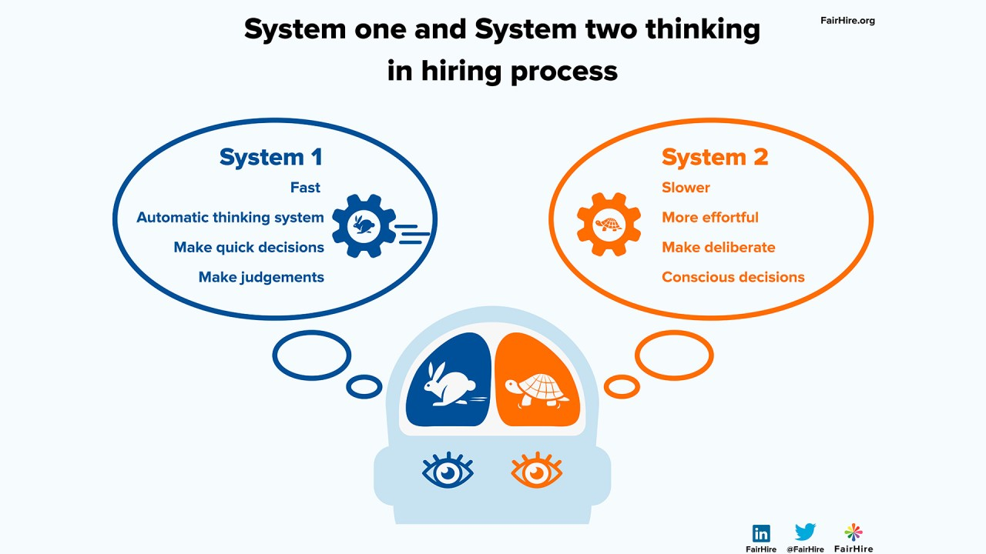
Level 2: Reasoners and OpenAI o1 Model

Slide 53
OpenAI o1 Demo
https://chatgpt.com/

Slide 54
Now we have Two Fundamental Scaling Laws
Training
Inference
Improvements in performance in LLMs been due to increases in model scale.
Size (number of parameters), training data volume, and computational resources.
Intelligence Requires Thinking.
The more you Compute the Higher Quality Answers You Provide.
This shift will move us from a world of massive pre-training clusters toward inference clouds, which are distributed, cloud-based servers for inference,
Notes:
https://www.facebook.com/share/r/1FHnoCVuq3/
https://www.facebook.com/reel/1245315079948292
https://www.reuters.com/technology/artificial-intelligence/openai-rivals-seek-new-path-smarter-ai-current-methods-hit-limitations-2024-11-11/

Slide 55
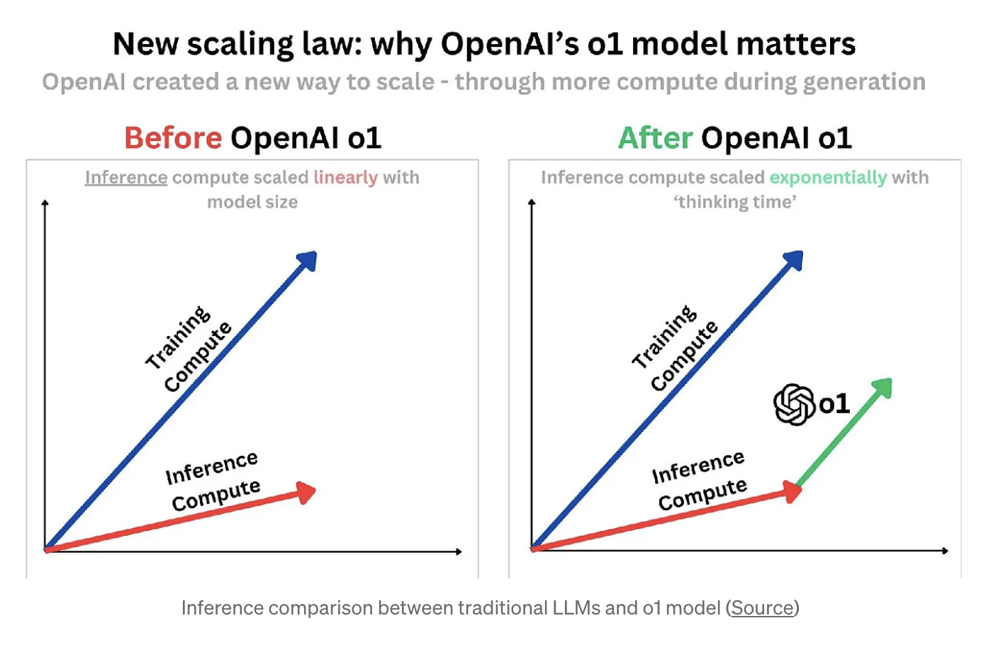
Notes:
https://medium.com/@aiml_58187/beyond-bigger-models-the-evolution-of-language-model-scaling-laws-d4bc974d3876

Slide 56
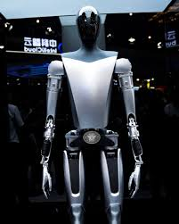
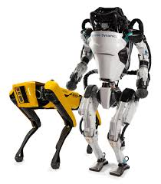
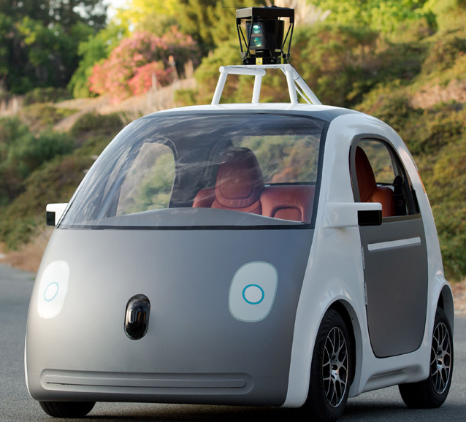
Level 3: Agentic AI
Agentic AI is like having a smart robot friend who can think and make decisions and take actions by itself, just like a real person.
Software Agents
Agentic AI
Physical Agents
Software agents are virtual entities that operate in digital environments. They perform tasks autonomously by interacting with software, data, and digital services.
Physical agents, also known as embodied agents, are AI entities that interact with the physical world. These agents often include humanoids, autonomous vehicles, and autonomous systems.

Slide 57
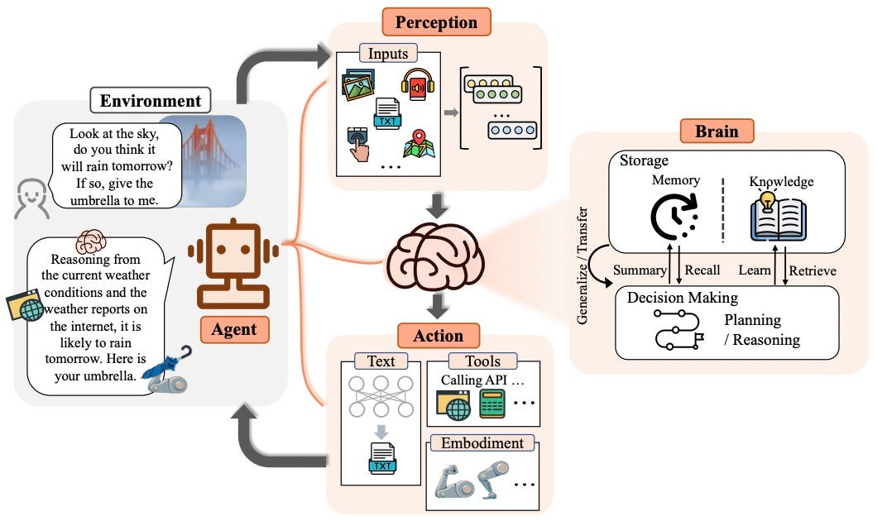
Level 3: Software Agents

Slide 58

Think of agents as the new apps for an AI-powered world.
Every organization will have a constellation of agents. They will work on behalf of an individual, team or function to execute and orchestrate businesses process.

Slide 59
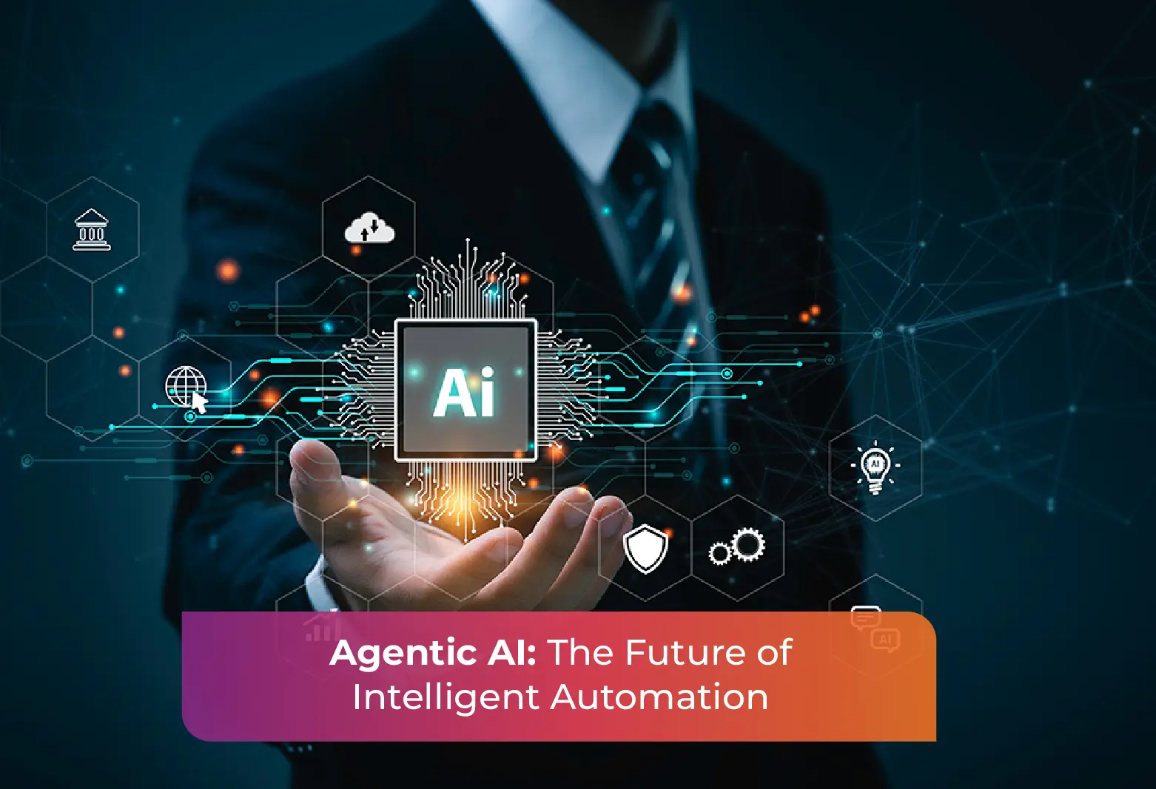

Slide 60
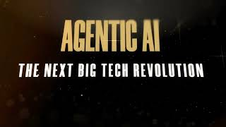

Slide 61


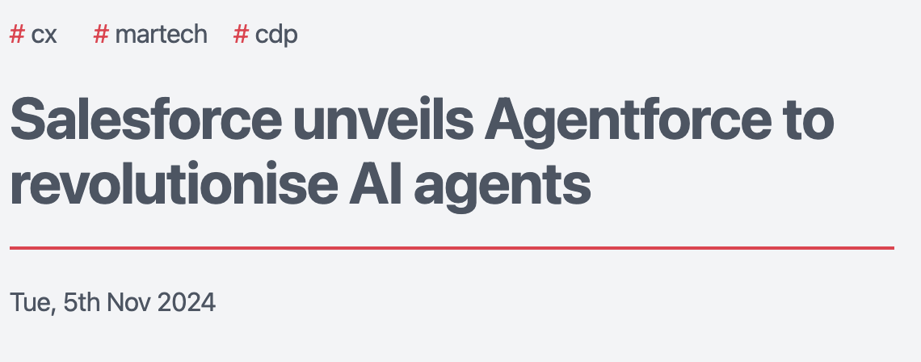
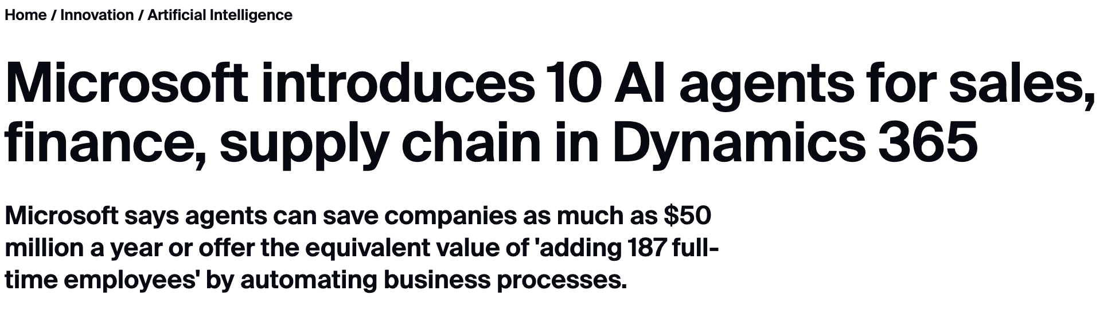
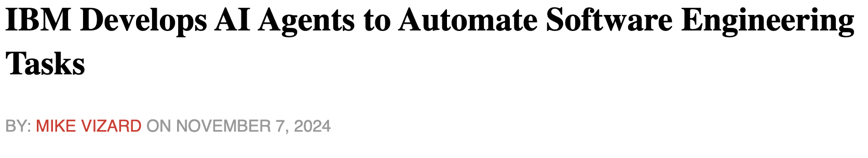

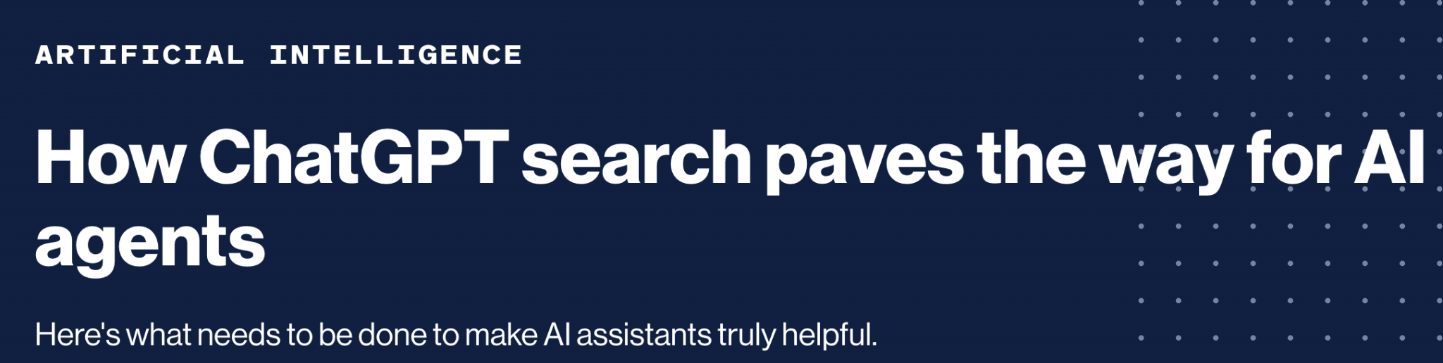

Slide 62
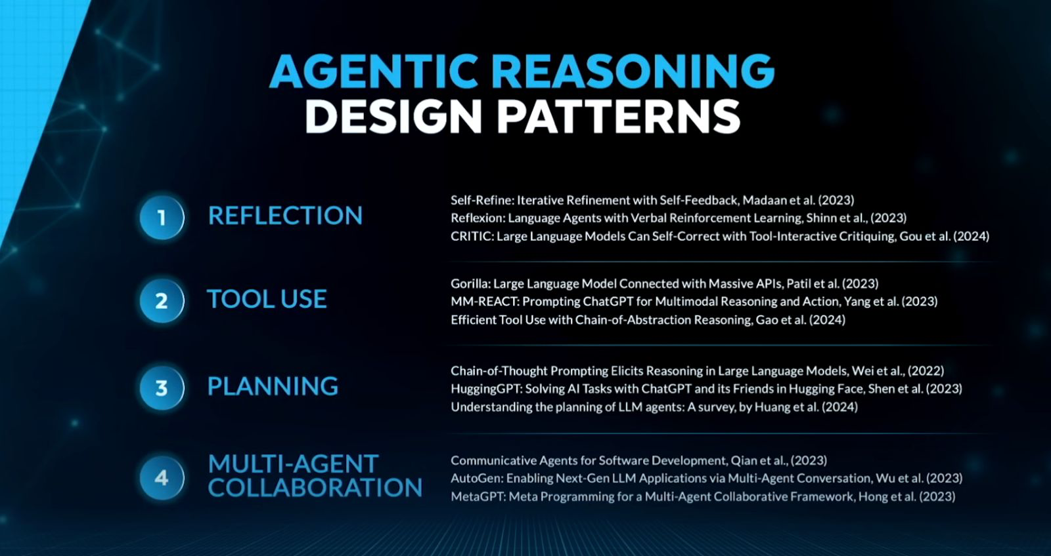
Notes:
https://www.youtube.com/watch?v=KrRD7r7y7NY

Slide 63
Level 4: Innovators
Description: At this level, AI systems are capable of aiding in invention and discovery. They can generate new ideas, propose novel solutions, and assist in creative processes.
Example: An AI that helps scientists discover new materials by analyzing vast amounts of data and suggesting potential compounds for experimentation.

Slide 64
Level 5: Organizations
Description: AI systems at this level can perform the work of an organization. They can manage operations, make strategic decisions, and coordinate complex tasks autonomously.
Example: An AI that runs a company, handling everything from supply chain management to employee scheduling and financial planning.

Slide 65
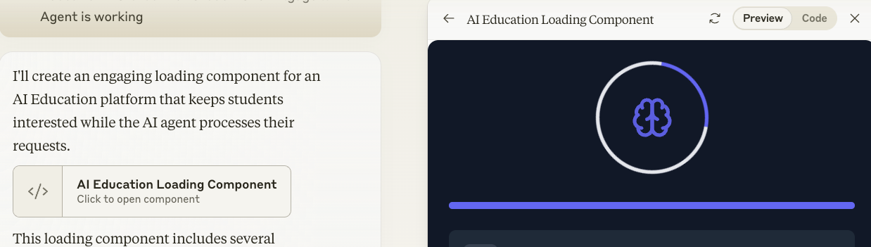
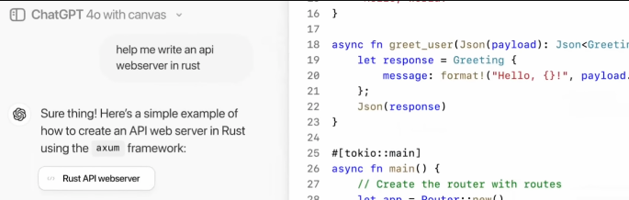
Hybrid UI for AI
Artifacts
Canvas
Merging conversational and graphical user interfaces to enhance user interaction.
Claude.ai Artifacts combines chat interactions with interactive, visual elements. They provide a dedicated window to instantly see, iterate, and build on the work you create with Claude.
OpenAI Canvas in ChatGPT is designed to enhance the writing and coding experience. The dynamic interface allow users to interact with AI in real-time within the Canvas window.

Slide 66
Hybrid UI
Graphical User Interface (GUI) Elements
Conversational User Interface (CUI) Elements
Dedicated Windows
Interactive Components
Version Control
Shortcuts and Menus
Dialogue-Based Interactions
Real-Time Feedback
Contextual Understanding
Notes:
You can indeed refer to these new types of interfaces as hybrid UIs, as they combine elements of both graphical user interfaces (GUI) and conversational user interfaces (CUI). Here’s a breakdown of how they mix these elements:
Graphical User Interface (GUI) Elements
Dedicated Windows: Separate spaces for viewing and editing content, such as documents or code, which enhance focus and usability.
Interactive Components: Features like diagrams, flowcharts, and other visual elements that users can interact with directly.
Version Control: Tools for managing different versions of content, often through dropdowns or selectors.
Shortcuts and Menus: Quick access to common functions, improving efficiency and workflow.
Conversational User Interface (CUI) Elements
Dialogue-Based Interactions: Users interact with the AI through natural language, making the interface more intuitive and user-friendly.
Real-Time Feedback: Immediate responses and suggestions from the AI, facilitating a more dynamic and engaging experience.
Contextual Understanding: The AI uses the conversation context to provide relevant and tailored assistance.
By blending these elements, hybrid UIs aim to provide a more integrated and seamless user experience, leveraging the strengths of both graphical and conversational interfaces to enhance productivity and engagement.

Slide 67
OpenAI Canvas Demo
https://chatgpt.com/

Slide 68
Claude.ai Artifact Demo
https://claude.ai/
Notes:
https://www.youtube.com/watch?v=ljwts47mZSI
Give this demo

Slide 69
What is an API?
An API (Application Programming Interface) is a set of rules and specifications that define how two pieces of software can communicate and exchange data with each other. It's like a messenger or translator that enables different systems or applications to interact seamlessly, even if they were created by different developers or written in different programming languages.
Think of an API as a restaurant menu. The menu provides a well-defined list of dishes (functions) that the kitchen can prepare, along with their ingredients (inputs) and prices (outputs). Customers (developers) can order from the menu without needing to know the inner workings of the kitchen (the underlying code).

Slide 70
API-AI Nexus
The API-AI nexus refers to the powerful intersection and growing interdependence between APIs (Application Programming Interfaces) and AI (Artificial Intelligence).
AI-Powered APIs:
APIs are increasingly incorporating AI capabilities, offering intelligent features.
APIs as Gateways to AI:
APIs act as the primary access points for developers and businesses to harness the power of AI models and services.

Slide 71
API-AI-Cloud Nexus
AI, API, and Cloud Nexus is a term that refers to the combination of artificial intelligence (AI), application programming interfaces (APIs), and cloud computing to create generative AI applications.
Cloud computing is the delivery of computing services, such as servers, storage, databases, networking, software, analytics, or AI, over the internet. Cloud computing allows users to access and use these services on demand, without having to buy or maintain their own hardware or software.
AI, API, and Cloud Nexus is a paradigm that enables rapid and creative development of generative AI applications, as well as efficient and cost-effective management of data and resources.

Slide 72
Could AI Create a One-Person Unicorn?
Solopreneur
The AI revolution has already minted dozens of unicorns—startups valued at $1 billion before going public. Now it will create a whole new type of startup: The One-Person Unicorn
Notes:
https://fortune.com/2024/02/04/sam-altman-one-person-unicorn-silicon-valley-founder-myth/

Slide 73
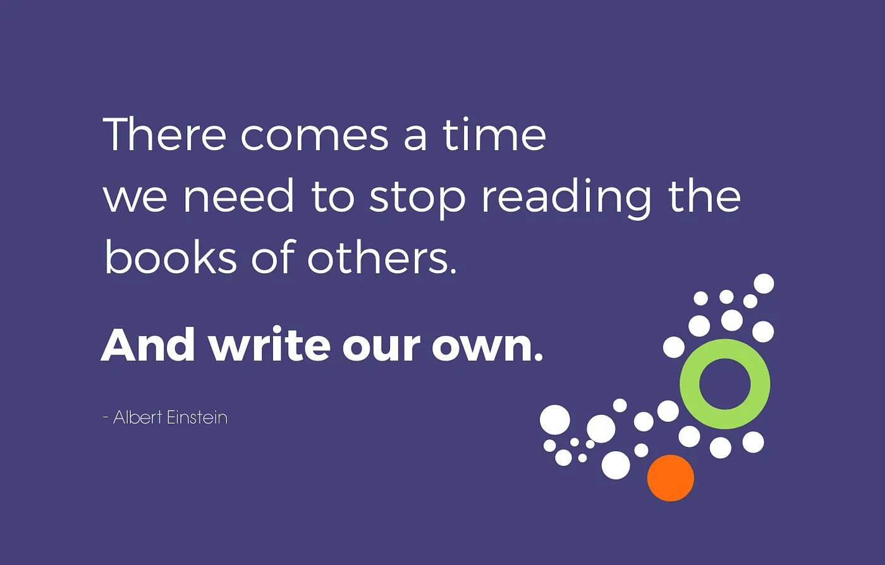

Slide 74
Audacious Leadership
Leading in a AI World

Slide 75
Audacious Leadership: Empowering You to Soar
Why Being Bold is Essential for Men and Women in Leadership Who want to Change Pakistan

Slide 76


Slide 77
Artificial Intelligence (AI) Revolution
There are certain chapters of history that come to be regarded as phase transitions for humanity, moments in which cultural evolution and the course of our individual, day-to-day lives shift in entirely new directions – for better or for worse.
We tend to call these historical shifts “revolutions”; think of the Agricultural Revolution, the Industrial Revolution, the Digital Revolution.
We are currently, living through what many have begun to call the Artificial Intelligence (AI) Revolution.
Notes:
https://www.thedrum.com/news/2023/11/30/reflecting-one-year-chatgpt-how-has-the-world-been-changed

Slide 78
Rethink Everything
‘We’re suddenly in a moment where it’s time to rethink everything’

Slide 79
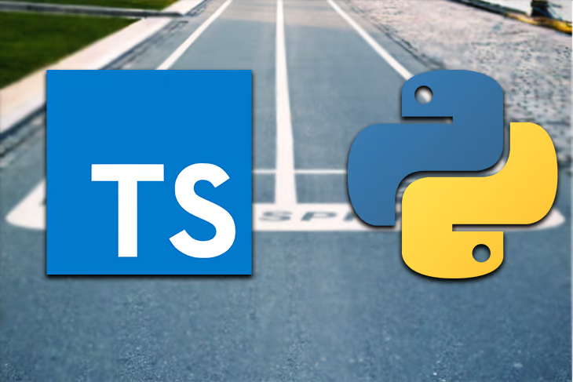
TypeScript Frontend / Python Backend

Slide 80

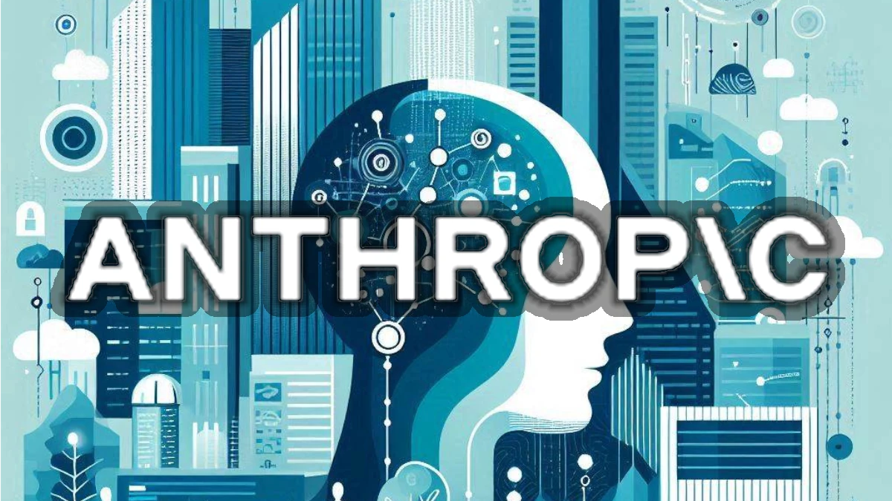








The Agentic AI Stack
Model Serving
Frameworks
Tools
Payments
Notes:
https://www.letta.com/blog/ai-agents-stack
https://docs.stripe.com/agents
https://techcrunch.com/2024/08/21/skyfire-lets-ai-agents-spend-your-money/

Slide 81




The Agentic AI Data Stack
The data pipeline must evolve from a system for storing and processing data to a system for creating knowledge and understanding.
Allow LLMs to understand not just the data itself, but the meaning and relationships behind it.
A unified platform that brings together all the data – from text and images to audio and video – to one place.
Has a semantic layer, utilizing dynamic knowledge graphs to capture evolving relationships.
To capture the relevant business metrics/logic required for building AI agents that understand the organization and domain-specific contexts for taking action.

Slide 82




Agentic AI Development Stack
Agentic AI
Hybrid UI
Agentic AI
Stack
API Stack
Cloud Stack
Physical AI Stack (Robotics)
TypeScript
Next.js
React
Tailwind CSS
Shadcn UI
Open Canvas
CrewAI
LangGraph
LangChain
GraphRAG
Neo4j
Pinecone
Neon
PyTorch
Python
UV
FastAPI
Neo4j/GQL
Kafka
Composio
Browserbase
Stripe/Skyfire
Docker
Docker Compose
Kubernetes
Serverless Containers
Github Actions
Terraform
Ray
Robotic Operating System (ROS 2)
NVIDIA Isaac
NVIDIA Project GR00T
Supports:

Slide 83
Building
Agentic AI Systems
Design & Build Intelligent
Vertical LLM Agents with Control

Slide 84
Agentic Architecture Components
01 Knowledge Engine
02 AI Core Interface
Knowledge Graphs in GraphDB
Context Aware Memory Systems
LangChain AI-first ToolKit
Modern Python
03 Agents with Control
04 Deploy & Scale
Design Cognitive Architectures
Build complex Agentic Systems.
LangGraph Platform/Server
Cloud Native Microservices
05 Hybrid UI
06 Monitor & Evals
Agentic UX Interface
Generative UI
Using LangSmith collaborate, test
& monitor your LLM applications.

Slide 85

Knowledge Engine
What is Memory?
Cognitive function for people to store, retrieve, and use info. to understand their present and future.
User Memories for AI Agents
To understand user needs and make decisions.
Knowledge Graphs:
A way to organize and connect different pieces of information, like creating a digital map of user data and application knowledge.
Create Knowledge Graphs for User Memories and Application Data Storage
Notes:
https://neo4j.com/blog/what-is-knowledge-graph
https://files.cdn.thinkific.com/file_uploads/967498/attachments/dc4/f52/87a/LangChain_Academy_-_Introduction_to_LangGraph_-_Long-Term_Memory.pdf

Slide 86

AI Core Interface
LangChain
Modern Python
AI First ToolKit with Reduced vendor lock-in in your LLM infrastructure design.
Enabling rapid development of AI Components and Intelligent Agents
Notes:
Langchain gives a complete set of interoperable building blocks to Build end-to-end applications with an extensive library of components. Future-proof your application by incorporating vendor optionality into your LLM infrastructure design.

Slide 87

LangGraph - Build Agents with Control
Orchestration framework for controllable agentic workflows
Gain precision and control to build agents that reliably handle complex tasks.
Controllable cognitive architecture for any task
Autonomous, but well‑behaved multi agent workflows

Slide 88
Deploy & Scale
LangGraph Platform
Self Hosted
Your Agentic AI Solutions will live in Cloud
Commercial solution for deploying agentic applications to production
Gives scalable Agentic Infrastructure for your Agents.
LangSmith helps to debug, test, deploy, and monitoring workflows.
Option 1: Use LangGraph Self Hosted Option to use their Agentic Infrastructure
Option 2: Build your own Agentic Infrastructure and Deploy on the Cloud of your Choice.
Notes:
LangGraph Platform allows you to focus on agent logic rather than server infrastructure. It provides Streaming Support, Background Runs, Support for long runs, Handling Burstiness, Double Texting, Checkpointers, Memory Management and Human-in-the-loop Support. https://blog.langchain.dev/langgraph-platform-announce/ https://langchain-ai.github.io/langgraph/concepts/langgraph_platform/#option-1-deploying-with-custom-server-logic

Slide 89

Speed & Agility in Agentic AI Development
Build Faster
AI helps create apps super quickly. Get things done in hours, not months
Code Smarter
AI is like a helpful coding buddy. Write code faster and better
Think Big
Small teams can build amazing things. Turn ideas into apps quickly
Real Example: NVIDIA AI, & Vercel hosted world's shortest hackathon (2-hour challenge)
Notes:
Developers are not being replaced but the pace of development has indeed increased at lot
https://www.linkedin.com/posts/nvidia-ai_vercel-and-nvidia-ai-are-hosting-the-worlds-activity-7260344727546298368-VuCK?utm_source=share&utm_medium=member_desktop

Slide 90
Key Themes
Evolution of Generative AI: The presentation charts the rapid progress of generative AI, highlighting the role of neural networks, GPUs, and transformers in enabling AI to think, learn, understand, and communicate.
Agentic AI as the Next Frontier: Khan argues that Agentic AI, capable of independent decision-making and action, represents the next significant step in AI development.
The "AI or Die" Mantra: The global race for AI dominance is emphasized, with companies and nations needing to embrace AI to thrive in the future.
Hybrid UI and the API-AI Nexus: The convergence of conversational and graphical interfaces, alongside the growing integration of AI with APIs and cloud platforms, is shaping the development landscape for AI applications.
The Potential of One-Person Unicorns: Khan suggests that AI empowers individuals to create highly valuable businesses, potentially disrupting traditional startup models.
Audacious Leadership in the AI Era: The need for bold and forward-thinking leadership is highlighted as essential for navigating the complexities and opportunities of the AI revolution.

Slide 91
Most Important Ideas and Facts
AI's Impact on Global GDP: AI is projected to add $15.7 trillion to the global GDP by 2030, underscoring its potential economic significance (Source: Gartner).
Two Fundamental Scaling Laws in AI: Intelligence in AI models is directly correlated with computational power, leading to a shift towards inference clouds for handling massive datasets and complex computations.
Levels of AI Development: The presentation outlines a hierarchy of AI capabilities, ranging from frontier chatbots and LLMs to reasoners, agentic AI, innovators, and ultimately AI systems capable of managing entire organizations.
Agentic AI Development Stack: A detailed breakdown of the technology stack required for building agentic AI systems is presented, encompassing knowledge engines, AI core interfaces, agents, deployment tools, UI frameworks, and monitoring solutions.
Speed and Agility for AI Engineers: The rapid pace of AI development necessitates agility and a strong understanding of modern tools and techniques.

Slide 92
Notable Quotes
"AI Thinks Like Our Brains! AI uses Neural Networks to think. Just like our brains have lots of tiny cells talking to each other, neural networks are like tiny computer helpers working together."
"Inference is like putting AI’s knowledge to work – generating answers, helping with tasks, and providing assistance instantly!"
"The Mantra of AI or die is real and certainly companies and countries that do not engage will die."
"Think of agents as the new apps for an AI-powered world. Every organization will have a constellation of agents. They will work on behalf of an individual, team, or function to execute and orchestrate business processes."
"We are currently living through what many have begun to call the Artificial Intelligence (AI) Revolution."
"We’re suddenly in a moment where it’s time to rethink everything’

Slide 93
Agentic AI Quiz
What role do neural networks play in AI, and how do they function?
Explain the significance of GPUs in AI processing and contrast them with CPUs.
How do transformers contribute to AI's ability to understand and generate human-like text?
Describe the two main steps in the AI model lifecycle, outlining their purpose and key characteristics.
What is the 'AI or Die' mantra, and what does it imply for companies and countries?
Differentiate between frontier LLMs and the OpenAI o1 model, highlighting their key features.
What defines Agentic AI, and how do software agents differ from physical agents?
Explain the concept of Hybrid UI for AI, and how it combines different user interface elements.
Define an API and its role in software communication, providing a real-world analogy.
Describe the API-AI-Cloud nexus and its significance in generative AI application development.
Notes:
Quiz Answer Key
1. Neural networks act as the 'brain' of AI, enabling it to think and learn. They consist of interconnected nodes that process information similarly to neurons in the human brain. This structure allows AI to recognise patterns, understand language, and make decisions.
2. GPUs are crucial for AI processing as they provide the computational power necessary for handling complex tasks quickly. Unlike CPUs, which process information sequentially, GPUs can perform many calculations simultaneously (parallel processing), making them significantly faster for AI applications.
3. Transformers are specialised algorithms that enhance AI's language processing capabilities. They enable AI to analyse large chunks of text simultaneously, understanding the relationships between words and their context. This leads to more accurate and human-like text generation.
4. The two main steps are training and inference. Training involves feeding massive datasets to the AI model to teach it language patterns and concepts. Inference is the stage where the trained model is used to generate responses to prompts, questions, or commands.
5. The 'AI or Die' mantra highlights the critical importance of AI adoption for survival in the modern world. It suggests that businesses and nations that fail to invest in and utilise AI risk falling behind and becoming irrelevant in the global landscape.
6. Frontier LLMs are AI models trained on vast datasets to understand and generate human-like text. The OpenAI o1 model is a specific example of a powerful LLM capable of performing complex tasks and providing contextually relevant responses.
7. Agentic AI refers to AI systems capable of independent decision-making and action-taking. Software agents operate within digital environments, while physical agents interact with the physical world, such as robots and autonomous vehicles.
8. Hybrid UI combines conversational and graphical user interface elements to enhance user interaction with AI. This approach integrates elements like chat windows, interactive components, and visualisations to provide a more intuitive and efficient user experience.
9. An API is a set of rules that enables different software applications to communicate and exchange data. It acts as an intermediary, similar to a restaurant menu, allowing developers to access functionalities of other applications without needing to understand their internal code.
10. The API-AI-Cloud nexus refers to the synergy between APIs, AI, and cloud computing in developing generative AI applications. This combination leverages the power of AI models, the accessibility of APIs, and the scalability of cloud infrastructure to create sophisticated and efficient AI-powered solutions.

Slide 94
Discussion Questions
Discuss the potential impact of Agentic AI on various industries and aspects of human life, considering both the benefits and risks.
Analyse the ethical considerations surrounding the development and deployment of AI, particularly in relation to bias, privacy, and job displacement.
Evaluate the role of government regulation and international cooperation in shaping the future of AI, ensuring responsible innovation and equitable access.
Evaluate the possibility of One-Person Unicorns, examining the implications for entrepreneurship and economic growth.
Critically assess the claim that we are living through an 'AI Revolution'. How does the current AI landscape compare to previous technological revolutions, and what are the potential long-term consequences for humanity?

Slide 95
Key Takeaways
The pace of AI development is accelerating, leading to increasingly sophisticated and capable systems.
Agentic AI, with its autonomous decision-making abilities, represents a significant leap forward.
This technology has profound implications for businesses, economies, and global power structures.
Leaders need to be bold and adaptable to harness the opportunities and navigate the challenges of the AI revolution.
Understanding the technical building blocks of Agentic AI is crucial for individuals and organisations aiming to stay ahead of the curve.

Slide 96
Call to Action
Embrace the opportunities presented by AI and actively engage in its development and application.
Cultivate audacious leadership to navigate the transformative potential of AI effectively.
Foster collaboration and knowledge sharing within the AI community to accelerate progress and ensure responsible AI development.

Slide 97

Presentation Discussion Podcast
https://notebooklm.google.com/notebook/7da48509-03b0-4c7d-8987-9f8952d786e2/audio
Note that you make change the speed of playback.

Slide 98

Detailed Syllabus
http://bit.ly/3CpZtTY

Slide 99

Whatsapp Channel:
Latest News
https://bit.ly/49werTR

Slide 100
Thanks
https://www.linkedin.com/in/ziaukhan/
https://www.facebook.com/ziakhan/
Published Presentation
https://bit.ly/4hTqT4G

